Slide 1
Russia Economic Outlook
September 2021
Annette Kyobe
Resident Representative Russian Federation

Slide 2
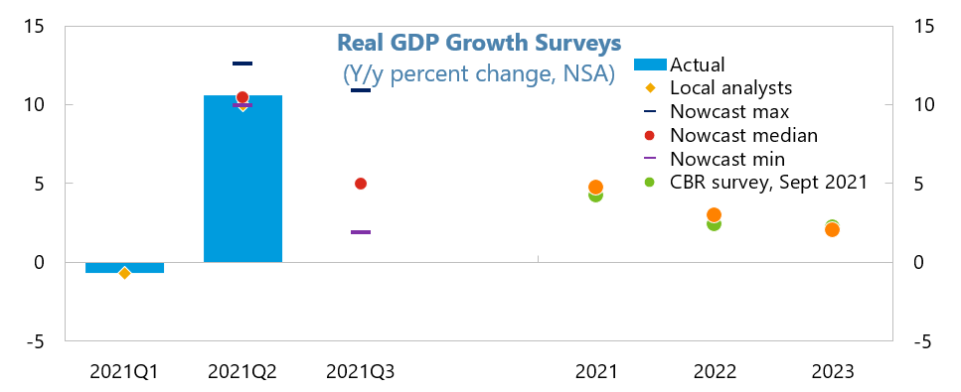
A strong recovery underway is peaking

Slide 3
Policies

Slide 4
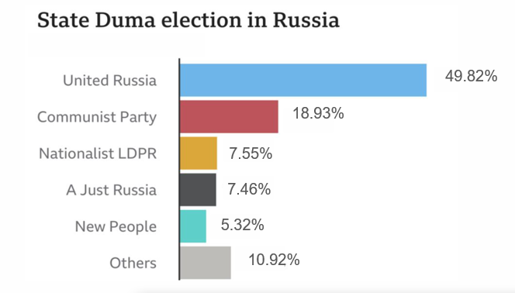
Results of parliamentary elections signal policy continuity

Slide 5
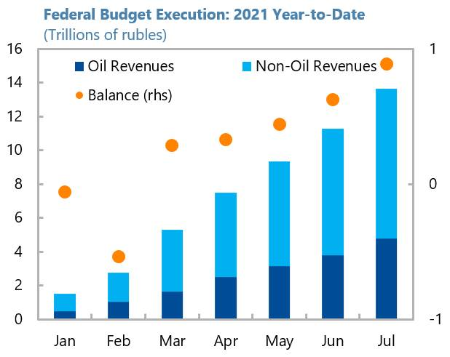
Higher non-oil revenues will be spent to support the economy

Slide 6
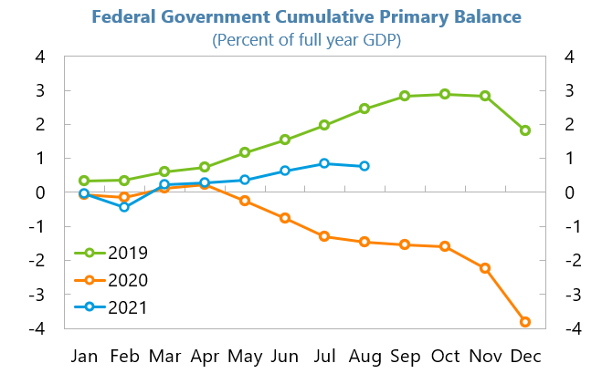
Budget will balance despite these new social support initiatives
Notes:
Modest normalization in 2021

Slide 7
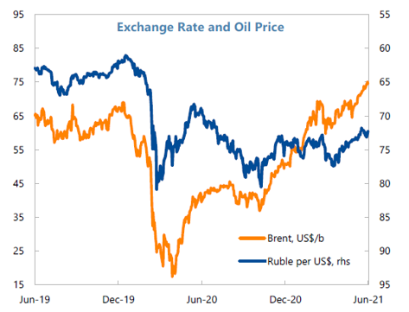
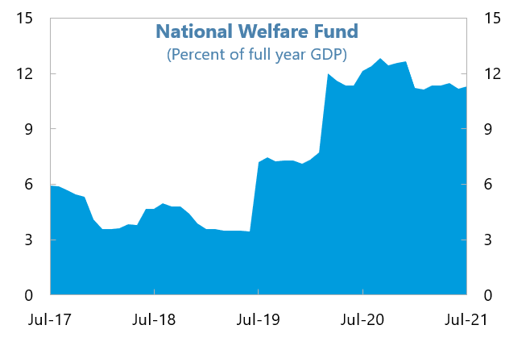
Higher oil revenues will finance investment
Notes:
Modest normalization in 2021

Slide 8
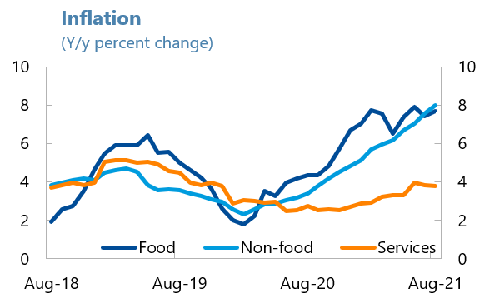
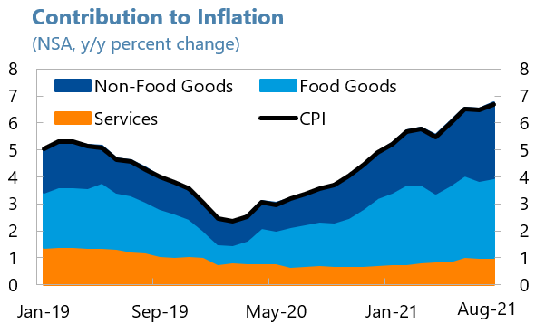
Inflation has surged but service sector inflation is contained

Slide 9
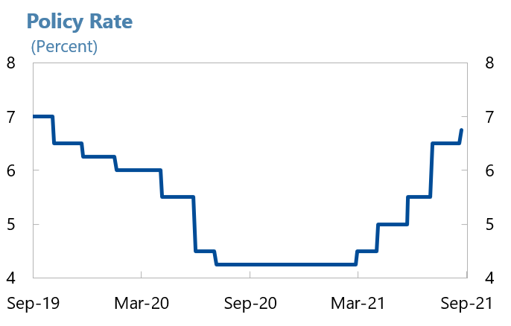
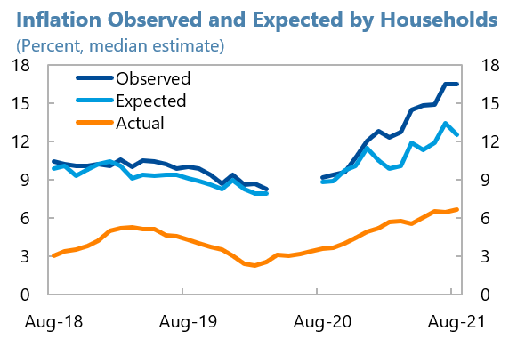
The BoR has hiked policy rates…

Slide 10
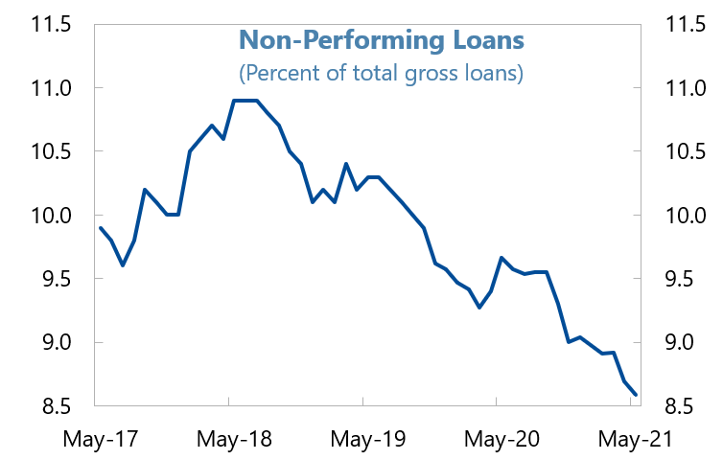
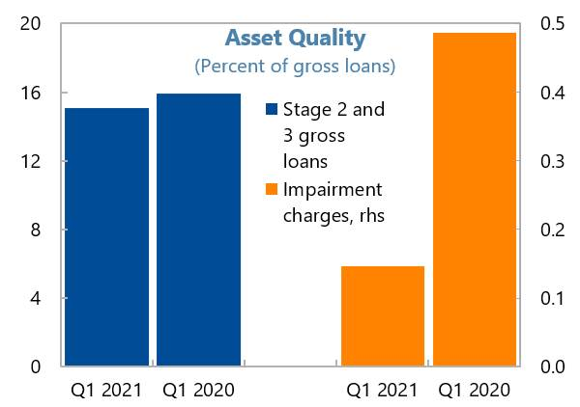
…. and ended regulatory forbearance with no cliff effects
Notes:
Non-performing loans and impairment charges have not increased much despite the roll-back of most forbearance measures in the banking sector.
In fact, NPLs are now at below pre-crisis levels

Slide 11
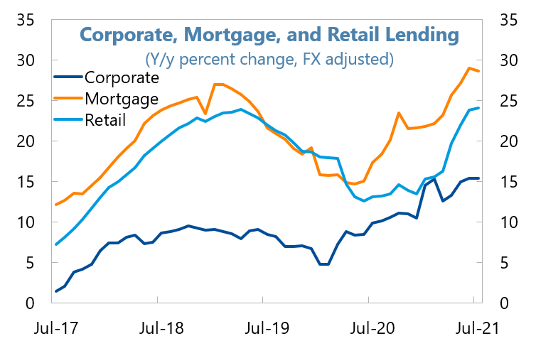
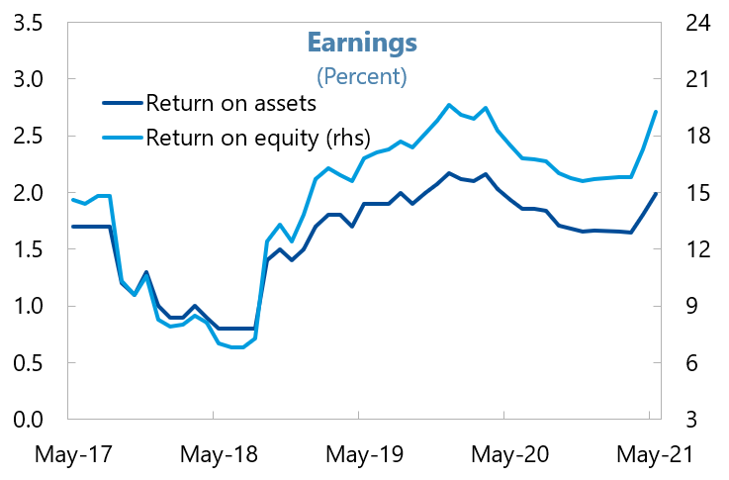
The banking sector is profitable

Slide 12
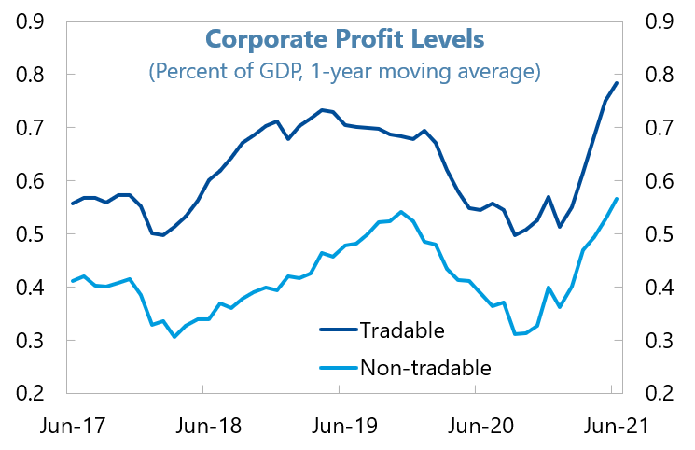
High corporate profits suggest high quality of loans

Slide 13
But uncertainty is high—with risks to the downside

Slide 14
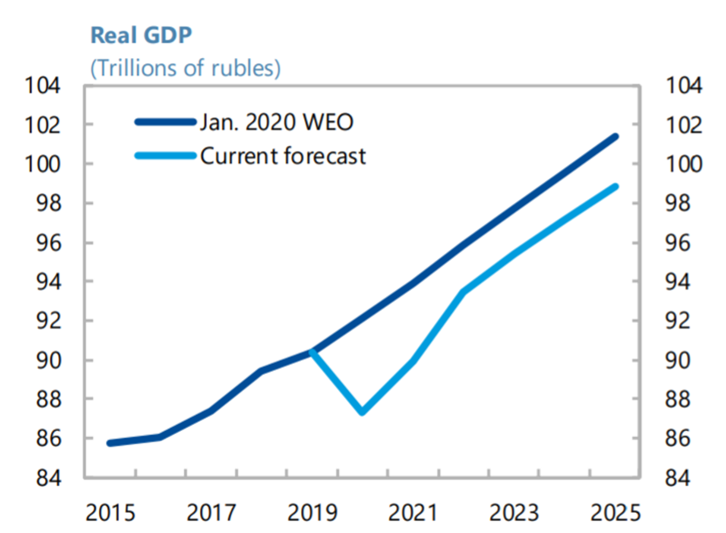
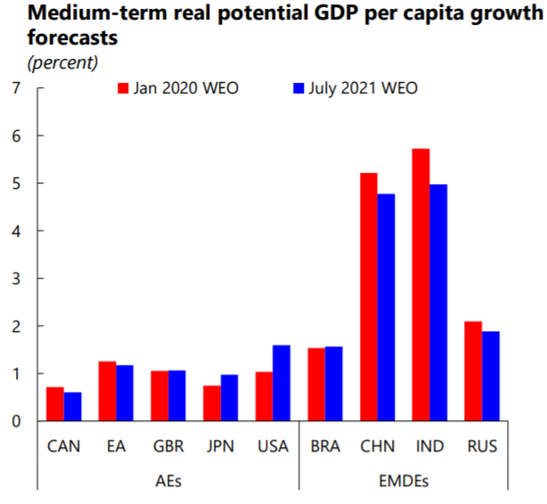
Policies should limit scarring and increase potential growth

Slide 15
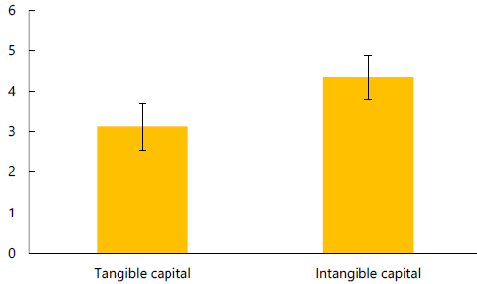
Lifting growth will require deep reform and investment
Investment and Productivity
Estimated impact from a ten percent rise in tangible and intangible capital on labor productivity, percent
Notes:
Enhancing resilience and lifting potential growth will require high-quality investments and important structural reforms

Slide 16
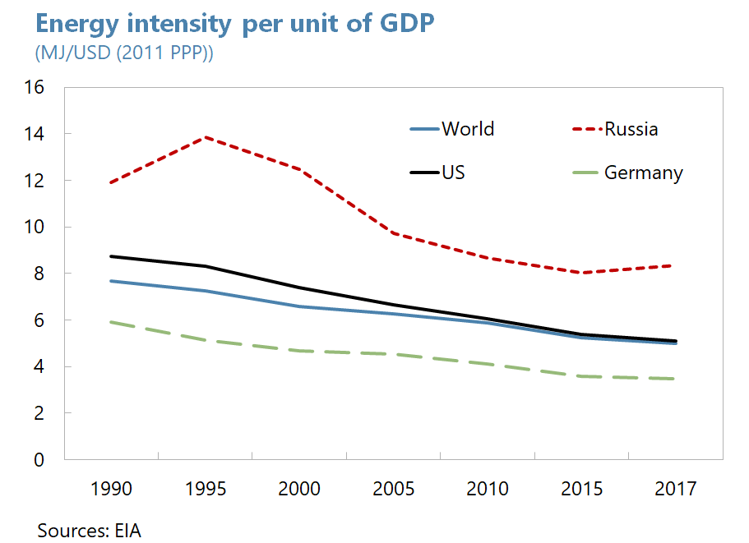
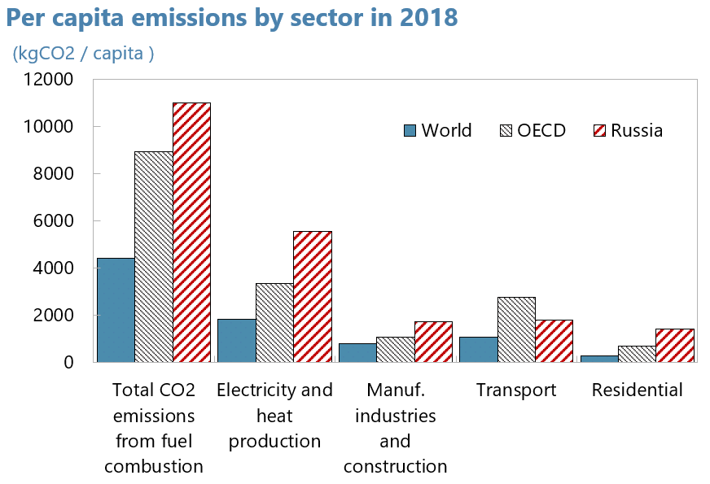
The green transition—a challenge—presents opportunities

