Slide 1
Geopolitical Risk and Global Banking
By Frederike Niepmann and Leslie Shen
Discussion by G von Peter, Head of International Banking and Financial Statistics, BIS
IMF Annual Research Conference, 6 November 2025
Disclaimer: The views expressed here mine and do not necessarily reflect the views of the BIS or its member central banks.

Slide 2
Clear paper with good data…
US bank b
Country c
US banks
Borrowers in the US
FFIEC 009 underpins BIS CBS

Slide 3
… clear empirical findings…
US bank b
Country c
(2) XB loans
(3) maintained
GPR_{bc}
PD_{bc}
US banks
(4) C&I loans
Spillover
Borrowers in the US

Slide 4
… and interesting mechanism: expropriation risk
US bank b
Country c
(2) XB loans
(3) maintained
GPR_{bc}
PD_{bc}
US banks
(4) C&I loans
A Balance sheet L
Loans
Claims
Local deposits
Borrowers in the US

Slide 5
Q1: The spillover is surprising – small in the aggregate?
US bank b
Country c
(2) XB loans
(3) maintained
GPR_{bc}
PD_{bc}
US banks
(4) C&I loans
Spillover
Substantial GPR may affect <1% banks’ total assets
How can GPR affect C&I so much?
→ Beyond sensitivity, estimate aggregate effect
Borrowers in the US

Slide 6
Asymmetric response: cross-border vs local
US bank b
Country c
(2) XB loans
(3) maintained
US banks
A Balance sheet L
Loans
Claims
Local deposits

Slide 7
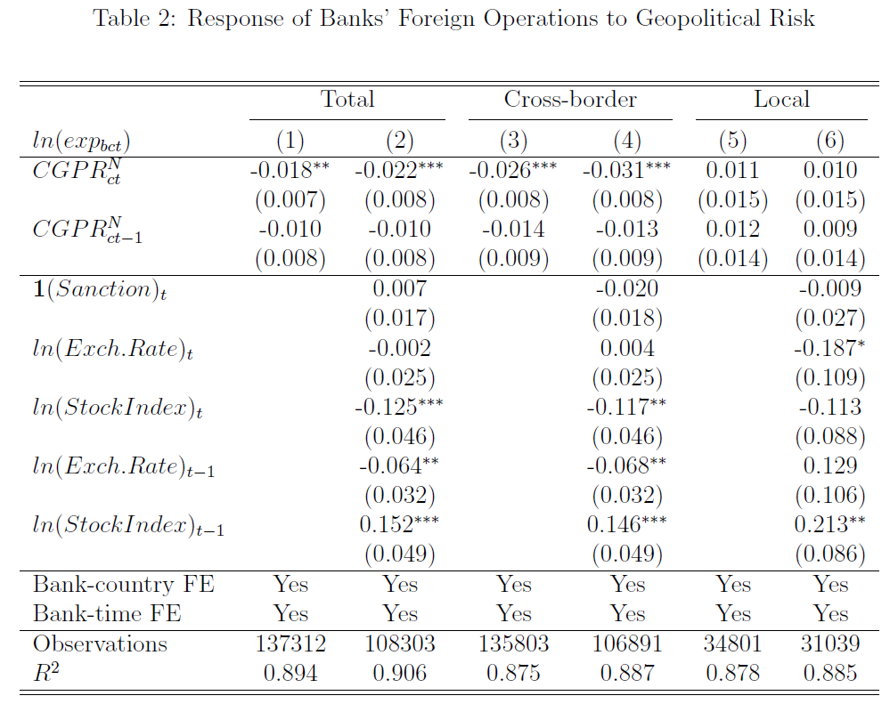
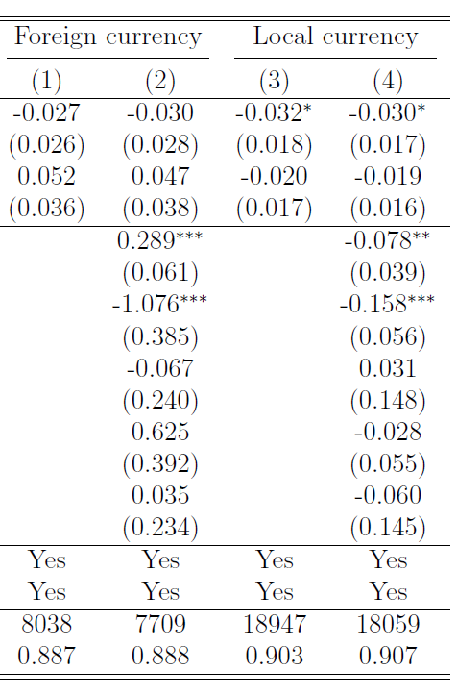
Q2: Confounding GPR and exchange rate?

Slide 8
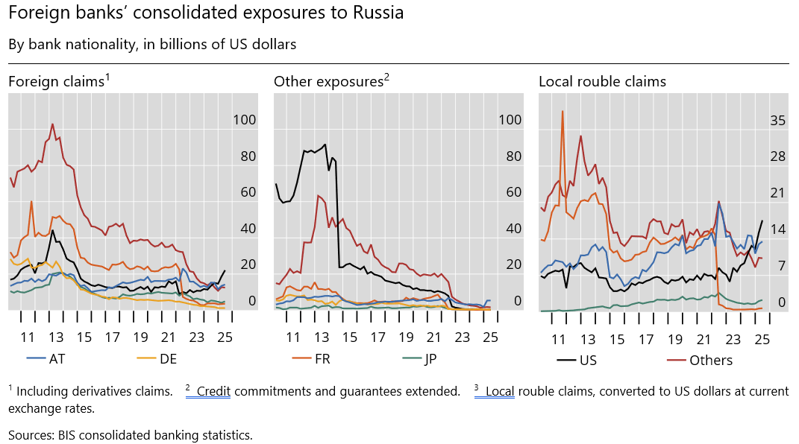
Q3: Are US banks representative?
Cross-border positions did fall more than local credit: slow to withdraw (few disposals)
US banks expanded local rouble credit in spite of valuation effects

Slide 9
Q4 Geopolitical risk = expropriation risk?
Paper focuses on expropriation risk as the distinctive feature of GPR
One risk, same response?
In 2022-23, 48 countries (“The West”) imposed sanctions on Russia Global Sanctions database
Russia retaliated against Western banks
Western banks facing similar risk, yet their responses are distinct – why?
→ Empirics and model should allow for factors to explain why banks exhibit differences
Two suggestions for more nuance

Slide 10
Q5 Forms of expropriation: asset seizure vs nationalitsation
Paper treats all affiliates as subsidiaries
Local affiliates 100% funded by local deposits
Not liable for deposits if expropriated
That’s nationalisation
If so, choice is clear: when the risk of that increases
Cross-border credit: lose assets, still owe liabilities → reduce exposure
Local credit: lose assets and cancel liabilities → maintain
Fact check: Russia 2022
All affiliates are subsidiaries RU: true, by law
Funded 100% with local deposits RU: fair approximation
Cancel deposits if assets expropriated RU: only seized assets Liabilities are still due
A Balance sheet L
Loans
Claims
Liabilities

Slide 11
Q6 More institutional background to nuance the argument
The form of incorporation matters (not tested)
Fiechter et al 2011 (IMF), Cerutti et al (2007), Dell’Ariccia et al (2010)
Subsidiaries: stand-alone, like domestic banks → parent’s loss is limited to equity stake
True not just for expropriations – legal design
Branches: part of parent’s balance sheet → expropriated assets; parent still owes liabilities
Faced with asset seizures, branches would also reduce credit
Testable, strengthens argument by contrasting
Local credit by subsidiaries vs credit by branches (behave like cross-border?)

Slide 12
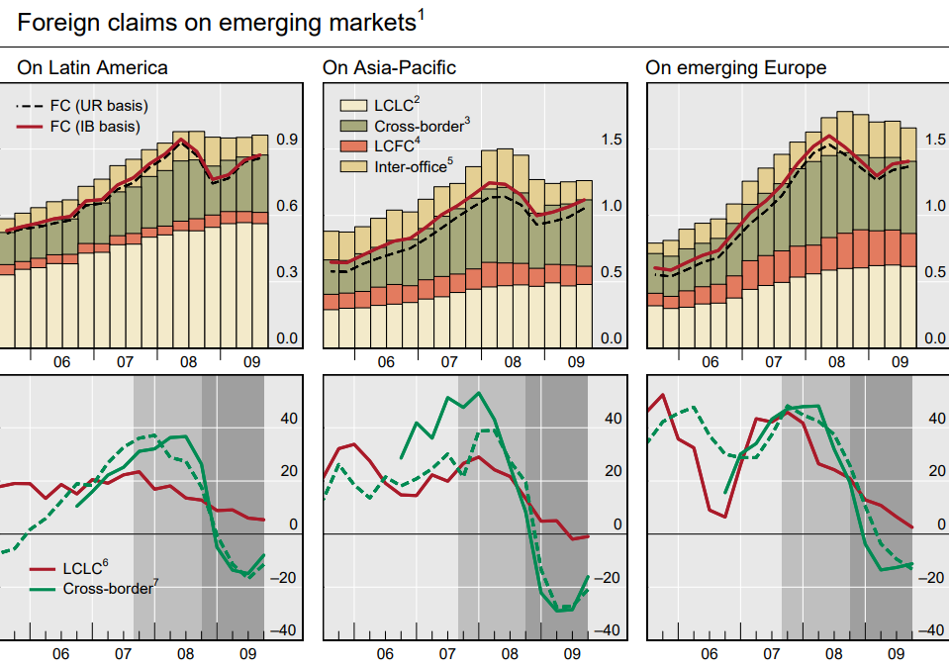
Q7 What other differences could explain the results?
A Balance sheet L
Loans
Claims
Local deposits
Other funding
Capital
Cross-border credit is generally more volatile than local credit
may well respond more to any risk or event
evident from the GFC (related BIS papers)
Role of business model → funding structure
In GFC, affiliates shrank more when funded:
cross-border
in foreign currency
interbank
Most stable: local intermediation [slide]
Bank fixed effects may not suffice
Distinguish affiliates’ funding models

Slide 13
In sum
Intriguing paper offering a compelling narrative
Good data: consolidated bank supervisory country exposure data
Clear empirical findings: cross-border versus local lending
Interesting mechanism: expropriation risk
Questions / suggestions
Disentangle GPR and exchange rate effects
Examine institutional nuances:
asset seizure vs nationalisation
branches vs subsidiaries
Consider alternative explanations for why banks exhibit different responses
Funding structure
Thank you

Slide 14
Extra slides

Slide 15
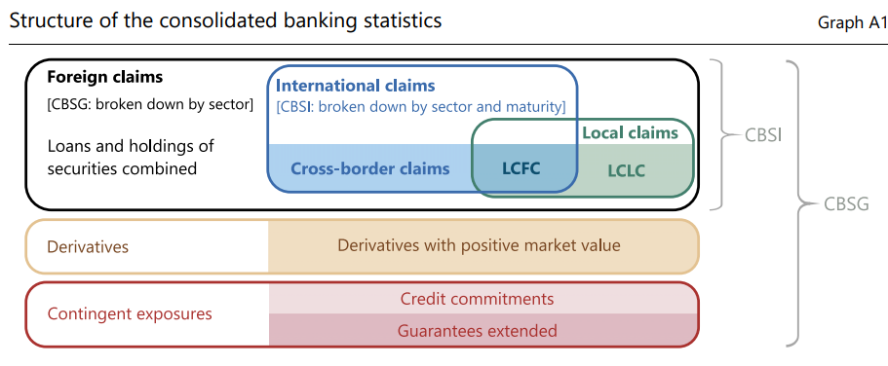
Consolidated banking statistics
FFIEC 009 data used in Niepmann-Shen is the US bank-level data underlying the BIS CBS
Country risk reference article: Hardy, McGuire and von Peter 2024
Claims comprise loans and holdings of securities (debt and equity)
Foreign claims (FC) are claims on counterparties outside the bank’s home country
Local claims abroad booked by affiliates (subsidiaries and branches)

Slide 16
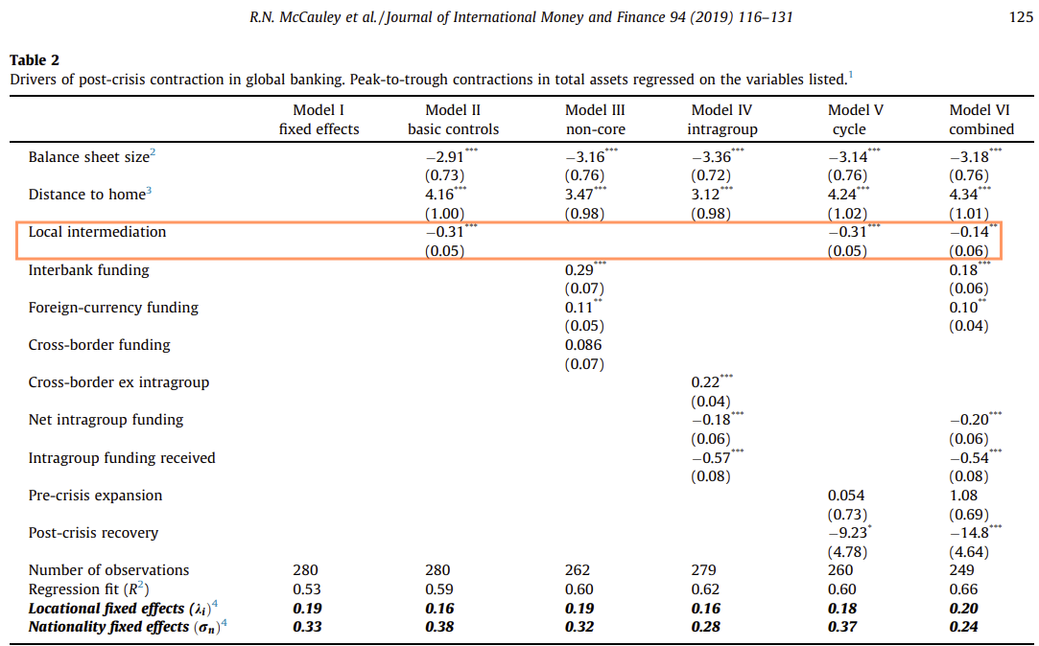

Sensitivity of credit depends on how affiliates fund themselves
In GFC, affiliates with more local intermediation contracted less
Affiliates shrank when funded
cross-border
foreign currency
interbank
Related BIS work:
McCauley et al 2010
McGuire von Peter 2016
McCauley et al 2019

