Slide 1

A World in Transition:
Are We Ready to Adapt?
Kristin Forbes
MIT-Sloan School of Management, NBER & CEPR
26th Annual Research Conference
International Monetary Fund
November 6, 2025

Slide 2
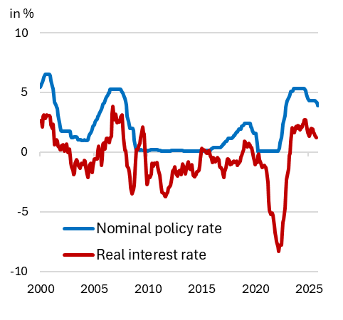
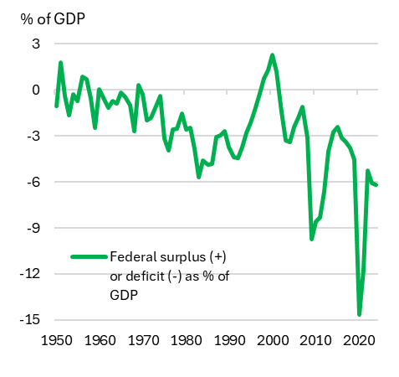
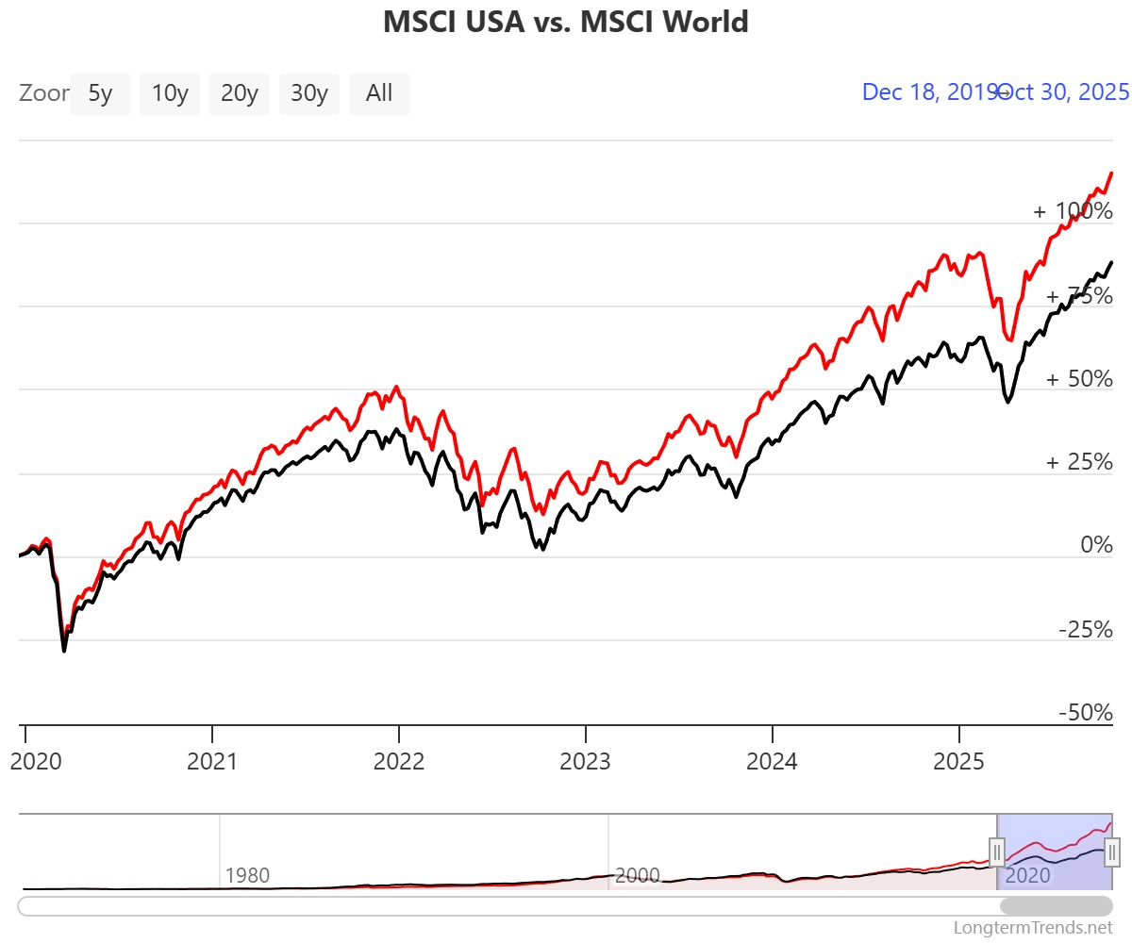
Resilience in the US Economy
MSCI Equity Indices:
USA vs. World
US Interest Rates
Nominal vs. Real
US Fiscal Balance
(Federal)
% change from 1/1/20
MSCI USA
MSCI World
Source: Longtermtrends.net
Source: FRED for data on nominal rates and inflation; authors calculations for real rate.
Note: Real rate is calculated as nominal rate less PCE inflation.
Source: IMF, WEO database (10/25)

Slide 3
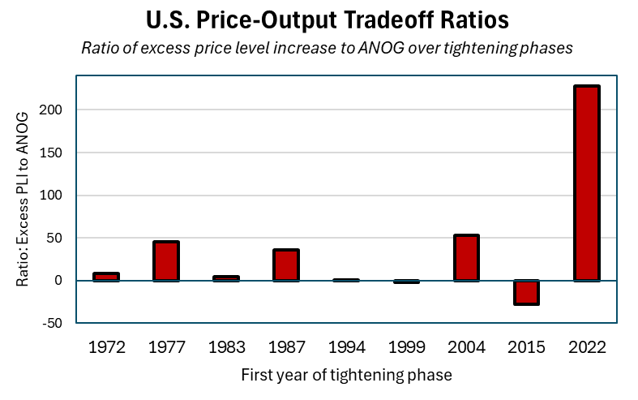
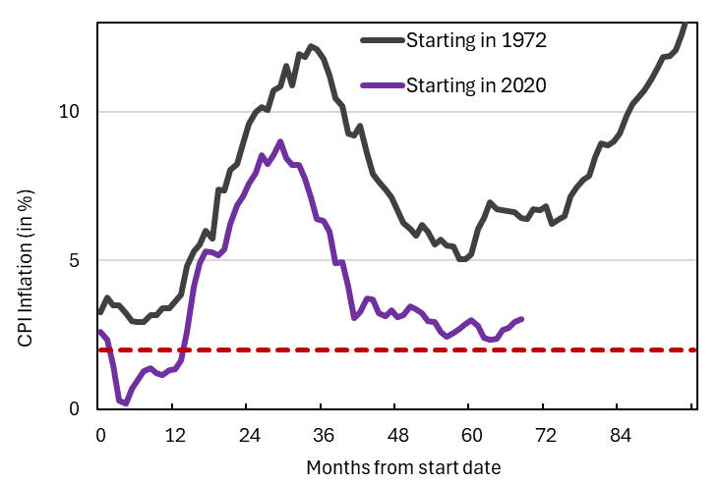
Risks from Monetary Policy?
CPI Inflation: 1972 vs 2020
Note: Ratio is calculated as the accumulated excess increase in the PCE price level (above 2% inflation) relative to the accumulated negative output gap over each tightening phase.
Source: Based on analysis in Forbes, Ha and Kose (2025), “Tradeoffs over Rate Cycles: Activity, Inflation and the Price Level,” NBER Macroeconomics Annual (April).

Slide 4
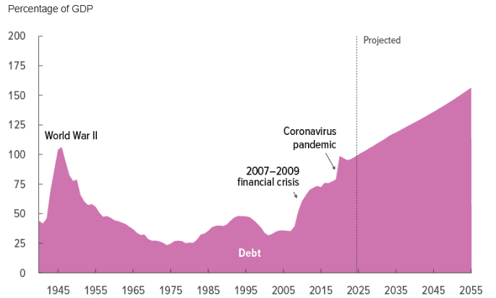
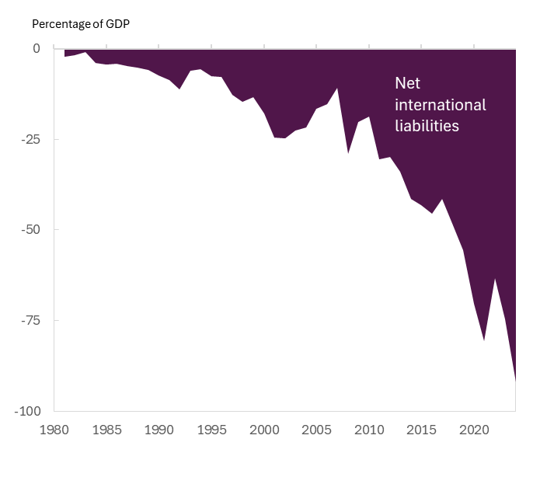
Risks from Fiscal Policy?
US Federal Debt Held by Public
US Net International Investment Position (NIIP)
Source: Long-Term Budget Outlook: 2025-2055. CBO. (March 2025)
Source: Adjviev, Forbes and Nenova (2025)

Slide 5
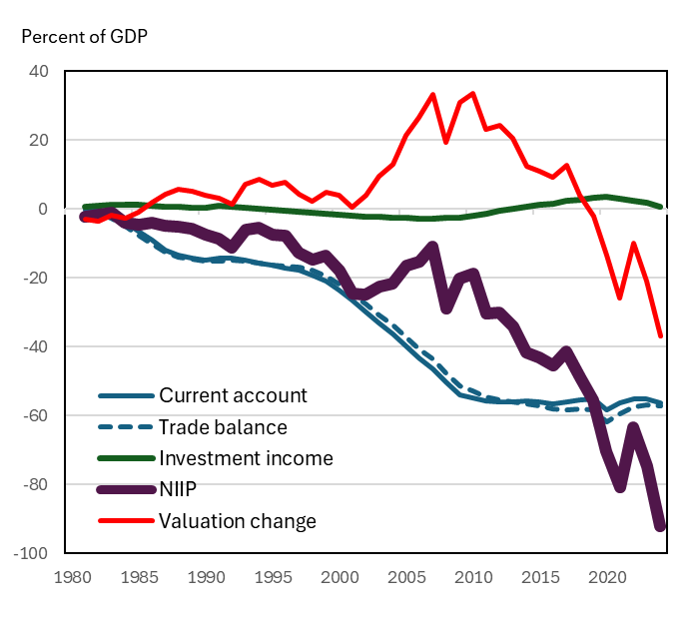
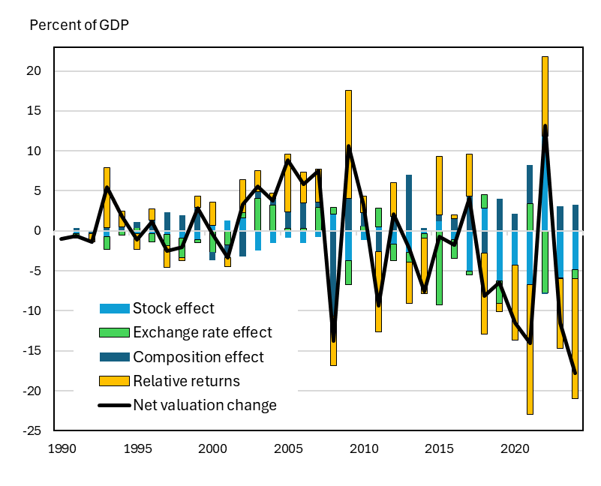
Explaining Changes in the US NIIP Position
Decomposing the US NIIP
Decomposing US Valuation Changes
Source: Adjviev, Forbes and Nenova (2025), update of Forbes, Hjortsoe and Nenova (2017)

Slide 6
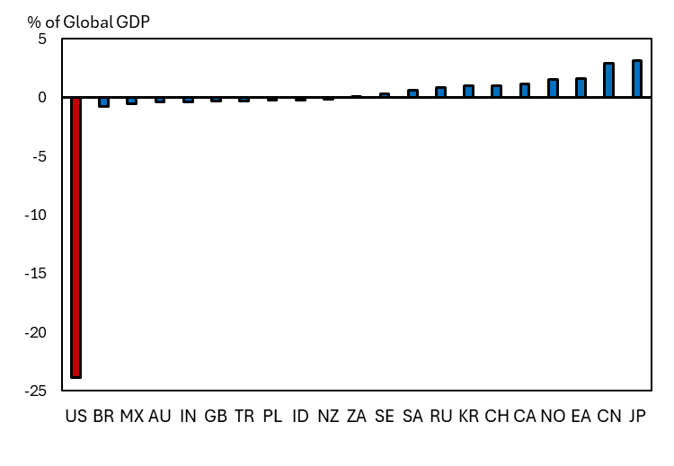
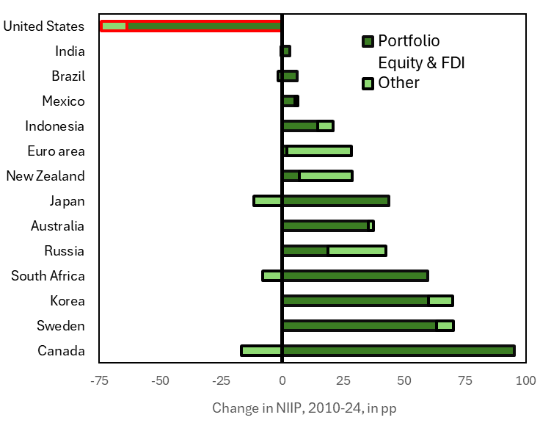
Important Implications for World
NIIP Positions as % of Global GDP in 2024
Change in NIIP as % of Domestic GDP, 2010-2024
Source: Adjviev, Forbes and Nenova (2025)

