Slide 1

Tackling High Inflation in Emerging Markets
May 17, 2023
Presentation at Banco Central do Brasil
Gita Gopinath
First Deputy Managing Director International Monetary Fund

Slide 2
Overview and key issues
What factors have accounted for the solid performance of emerging markets (EMs) in the current global tightening cycle?
What is the appropriate strategy for bringing inflation back to target?
How should EM central banks respond to financial stresses that may pose tradeoffs in achieving price stability goals?
How can fiscal policy help in the fight against inflation?

Slide 3
Many EMs have held up well in environment of sharply rising global rates
EMs tightened earlier and more aggressively than AEs…
…which helped keep capital outflows limited.
Ex-ante real monetary policy rates
(Percent)
Latin America: Cumulative bond flows
(Percent of initial allocation)
Sources: Consensus Economics; Haver Analytics; national authorities; and IMF staff calculations.
Note: Real policy rate is the difference between the nominal rate and one-year ahead inflation expectations. Aggregates are PPP GDP-weighted averages. Emerging markets = Hungary, India, Indonesia, Malaysia, Philippines, Poland, Romania, Thailand; LA5 = Brazil, Chile, Colombia, Mexico, Peru.
Sources: Emerging Portfolio Fund Research (EPFR) database; Haver Analytics; and IMF staff calculations.
Note: Global Financial Crisis (9/10/2008); Taper Tantrum (5/22/2013); Fed Hike (1/5/2022).

Slide 4
Improved credibility of monetary policy frameworks has helped ease tradeoffs for central banks
Frameworks in EMs improved markedly in the past two decades..
..which has helped improve anchoring of expectations across EMs
EMs: Central bank transparency and IT frameworks
EMs: Inflation expectations anchoring, 2005-21
(Left scale: percentage points; Right scale: index, lower=better anchored)
Sources: Rawat, Ye, and Gelos (2020)
Note: The Central Bank Transparency Index (Dincer, 2019) measures political, economic, procedural, policy, and operational transparency. The chart shows the increase in mean transparency among EMDEs over time.
Sources: Consensus Forecasts, IMF staff calculations.
Note: EMs include BGR, BRA, CHL, COL, HUN, IDN, IND, MEX, MYS, PER, PHL, POL, ROU, RUS, and THA. Average is PPP-weighted; LT=long term.

Slide 5
Reduced financial vulnerabilities also contributed to resilience of EMs
EM banking sectors are better capitalized…
…and reserves increased until the pandemic
EMs: Tier-1 capital
(Percent of risk-weighted assets)
EMs: Reserve assets
(Percent of GDP)
Sources: IFS, WEO, IMF staff calculations.
Note: Aggregates are PPP GDP-weighted averages. Emerging markets = Hungary, India, Indonesia, Malaysia, Philippines, Poland, Romania, Thailand; LA5 = Brazil, Chile, Colombia, Mexico, Peru.
Sources: IMF, World Economic Outlook database; and IMF staff calculations.
Note: Average is purchasing-power-parity GDP-weighted. Emerging markets = Brazil, Chile, Colombia, Hungary, India, Indonesia, Malaysia, Mexico, Peru, Philippines, Poland, Romania, Thailand.

Slide 6
Financial markets remain optimistic about inflation
Markets expect inflation to fall relatively quickly including in EMs…
…which would allow policy rates to fall starting this year.
Inflation relative to mid-point of target range
(Percent)
Policy rate: Historical and forecast
(Percent)
Sources: Bloomberg, IMF WEO, IMF staff calculations.
Sources: Historical from national authorities; Forecasts from Bloomberg; and IMF staff calculations.

Slide 7
However, inflation has proved persistent
Core inflation remains high…
…and services inflation has picked up markedly
Core inflation
(Percent, year-on-year)
Services inflation
(Percent, year-on-year)
Sources: Haver, OECD, and IMF staff calculations.
Note: Median of year-on-year core inflation rates across AEs and EMs.
Sources: Haver, OECD, and IMF staff calculations.
Note: Median of year-on-year core inflation rates across AEs and EMs. ARG = Argentina; CHN = China; EA = Euro area; US = United States; TUR = Türkiye.

Slide 8
Monetary policy strategy

Slide 9
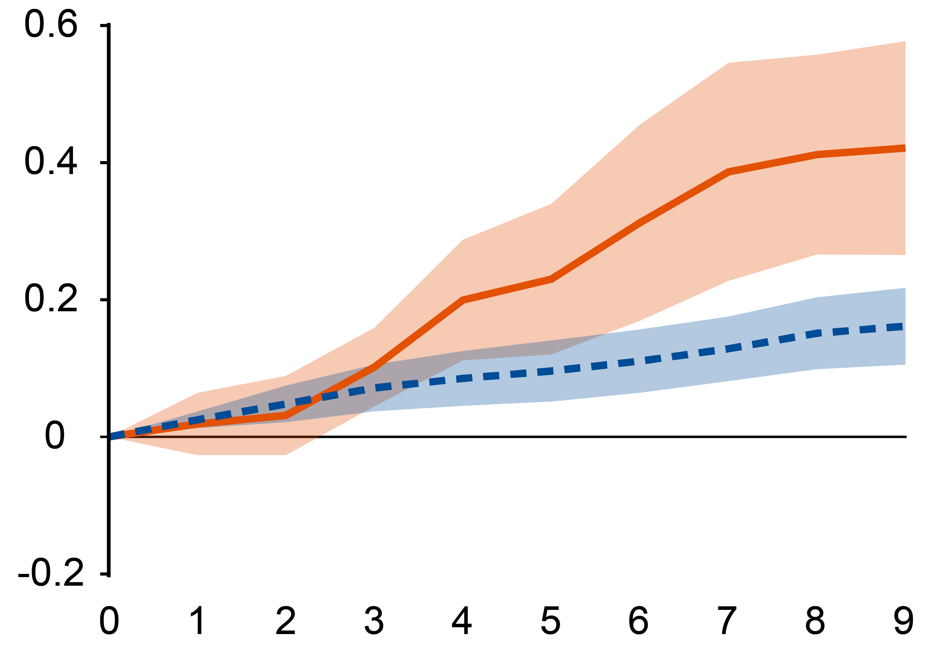
Risk of inflation persistence argues for maintaining tight monetary policy
Oil price shocks have a larger effect on CPI price levels in EMs
Several factors may help explain sticky inflation and pose upside inflation risks
Labor markets still strong and U* may have risen significantly
Wage and price indexation more prevalent in EMs than in AEs
EMs more vulnerable to upside inflation surprises given higher passthrough of shocks
Strong rationale for maintaining tight policies and reacting aggressively to upside inflation surprises
Core CPI response to an oil price shock
(Percent)
EM
AE
Quarter
Source: Baba and Lee (2022)
Note: Sample covers European EMs and AEs. The figure plots the responses to a 10 percent oil price shock

Slide 10
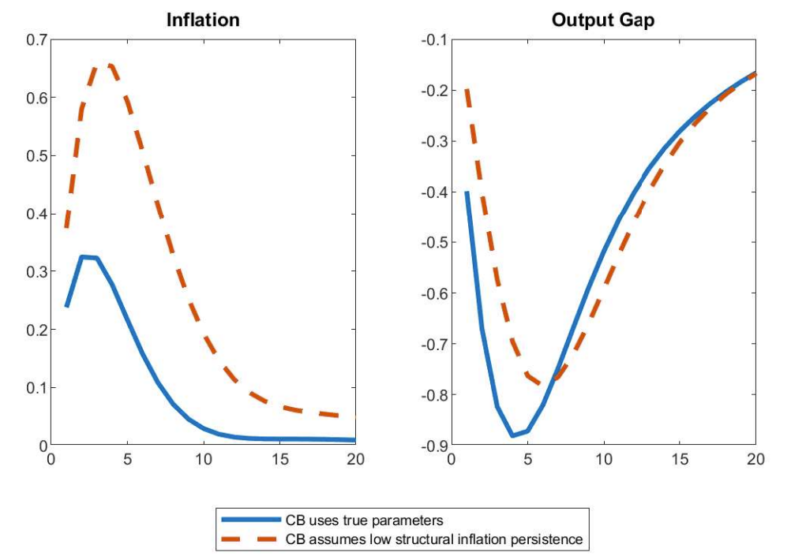
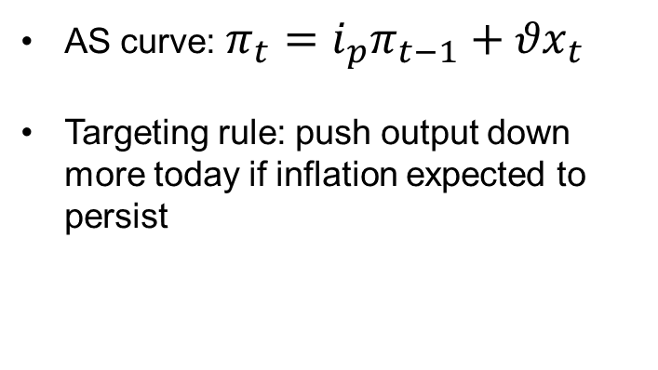
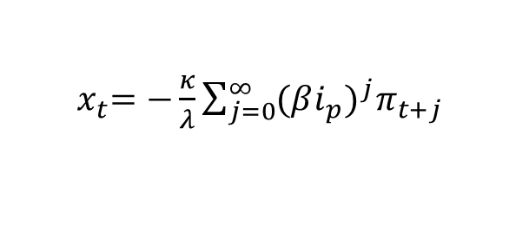
Risk management approach suggests reacting aggressively to upside inflation surprises…
Optimal targeting rule in simple New Keynesian model is instructive
AS curve: $π_{t}={i_{p}π}_{t−1}{+ θx}_{t}$
Targeting rule: push output down more today if inflation expected to persist
Model simulation: Cost shock under alternative targeting rules
${ x}_{t}=−\frac{κ}{λ}\sum_{j=0}^{∞}{{{(βi_{p})}^{j}π}_{t+j}}$
Simulation shows that cost shock generates large inflation runup when central bank underestimates inflation persistence.
Source: IMF staff calculations.

Slide 11
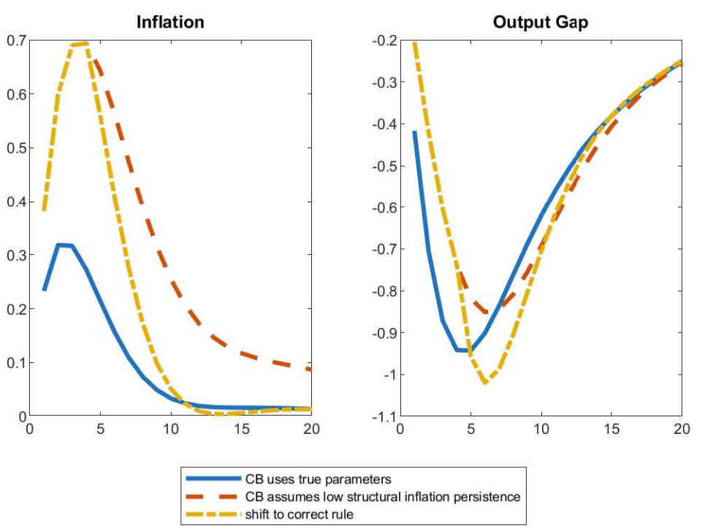
…as correcting for unexpectedly persistent inflation later is costly
Model simulation: Cost shock under alternative targeting rules
Simulation builds on previous one by assuming that central bank shifts to optimal rule (based on true structural persistence parameter) after a year.
Source: IMF staff calculations.

Slide 12
Monetary policy and financial stress

Slide 13
EMs may see heightened financial stresses
Financial stresses could affect EMs through different channels than AEs
Credit rather than duration risk; and pressures from capital outflows
Additional tools may improve tradeoffs, including liquidity support or ELA in FX
But should be used carefully, and be temporary/targeted
IMF’s Integrated Policy Framework aims to identify when suitable to use FXI or CFMs
Use needs to be guided by careful analysis of frictions and shocks

Slide 14
Capital outflow and exchange rate pressures
Policy Responses under Financial Frictions
 | Deep FX markets | Shallow FX markets
Low FX mismatches | Exposed to: Fundamental shocks (e.g., US tightening) Response: Adjust policy rate to stabilize inflation, allow depreciation. | Exposed to: Both fundamental shocks and UIP shocks Response: Fundamental shocks: policy rate and depreciation UIP shocks: FXI and reduction in inflow CFMs
High FX mismatches | Exposed to: Both fundamental shocks and sudden stops Response: Before shocks: may impose CFM/MPMs on FX inflows to reduce systemic financial risk After shocks: adjust policy rate and allow depreciation | Exposed to: Fundamental shocks, UIP shocks, and sudden stops Response: Fundamental shocks / sudden stops: CFM/MPMs to reduce systemic financial risk, adjust policy rate, allow depreciation Taper tantrums: FXI and reduction in inflow CFMs, keep policy rate unchanged

Slide 15
Fiscal policy and inflation

Slide 16
Fiscal tightening can help cool inflation, reduce public debt
Fiscal tightening can help fight global inflationary shock,…
…ease the burden on monetary policy,…
…and reduce public debt.
Core inflation
(Percentage points, year-on-year, deviation from baseline)
Policy rate
(Percentage points, annual percentage rate, deviation from baseline)
Government debt
(Percentage points, percent of GDP, deviation from baseline)
Source: Chen, Goncalves, Jakab, and Linde (2022)
Note: Simulations by IMF staff using a two-country dynamic stochastic general equilibrium heterogenous agent model based on Erceg and Linde (2012).
Notes:
(

Slide 17
Fiscal expansion likely to boost inflation and government debt, depending on how central bank responds
Critical to provide targeted support to vulnerable populations
But fiscal expansion boosts inflation and raises public debt
If CB reacts aggressively, then large increase in government debt
If CB accommodates, then large boost to inflation that may de-anchor inflation expectations
Output
(Percentage points, deviation from baseline)
Core inflation
(Percentage points, year-on-year, deviation from baseline)
Government debt
(Percentage points, percent of GDP, deviation from baseline)
Source: Chen, Goncalves, Jakab, and Linde (2022)
Note: Simulations by IMF staff using a two-country dynamic stochastic general equilibrium heterogenous agent model based on Erceg and Linde (2012).
Notes:
Scale this up

Slide 18
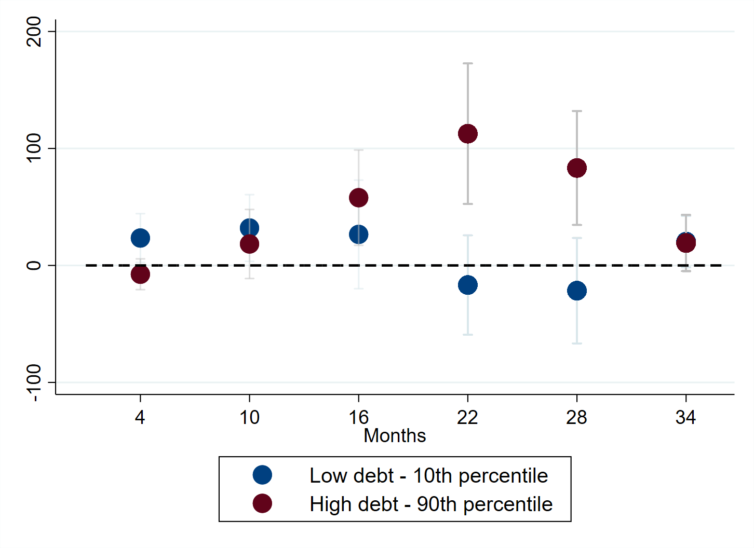
Government debt heightens key EM vulnerabilities
Higher debt raises EM sovereign default risk when global financial conditions tighten
Effects on domestic financial conditions may be amplified through sovereign-bank nexus
Weak fiscal position heightens risks of fiscal dominance and de-anchoring of inflation expectations
More government debt raises default risk and borrowing costs…
…and increases risk that inflation expectations de-anchor
Sovereign Default Risk Response to Financial Conditions Shock
(Percentage points)
5-yr Inflation Expectations response to a debt surprise
(Basis points)
Source: GFSR (April 2022)
Source: Brandao-Marques, Casiraghi, Gelos, Harrison, Kamber (2023).
Note: Sample covers EMs. The figure plots the responses to a 10 percent debt surprise.

Slide 19
Conclusions

Slide 20
Conclusion
Main monetary policy priority is to bring inflation credibly back to target
Insufficient monetary policy tightening now could necessitate more painful policy actions later
Fiscal policy should support monetary policy
Financial tools – judiciously used – can improve tradeoffs in event of pronounced stress
Crucial to maintain independent central banks with strong policy frameworks
Better frameworks – monetary and financial – have allowed EM central banks to pursue countercyclical policies and withstand AE policy tightening
Important to continue further refining and strengthening these frameworks
Enhanced central bank transparency and communication will be a key component
IMF heavily involved in promoting central bank transparency (including through CBT code reviews)

