Slide 1
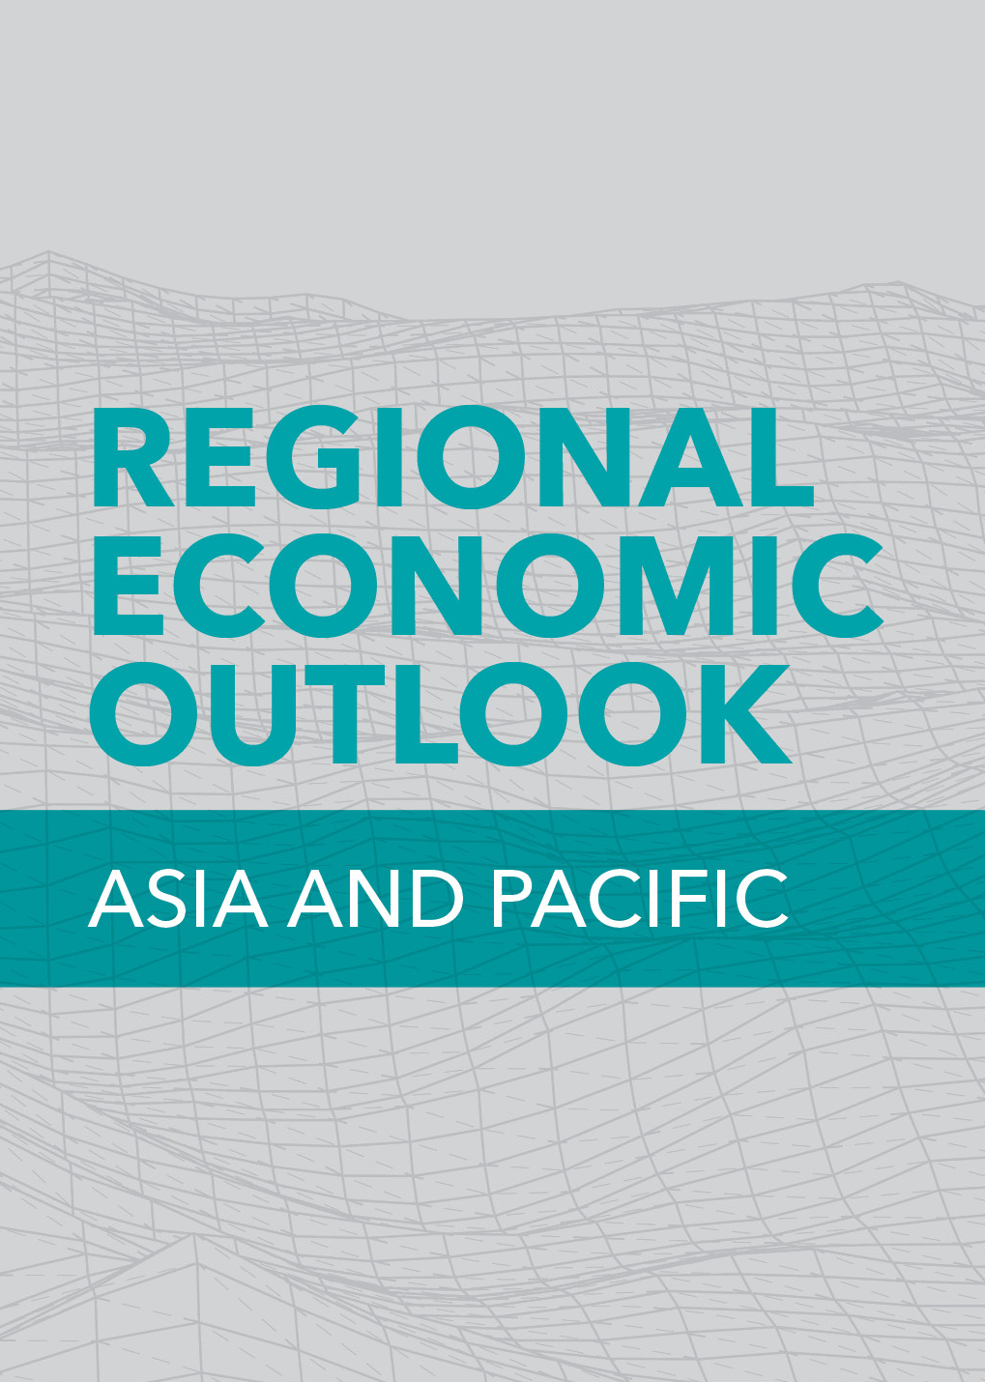
Recovery Unabated amid Uncertainty
Press Briefing
April 15, 2023

Slide 2
China’s reopening provides a boost to Asia’s growth
Economic activities have picked up in China after reopening, especially for services
China’s rebound will have positive spillovers to the region
China: Manufacturing and Services Indexes
(PMI Indexes subtracted by 50)
Source: Haver Analytics and IMF staff calculations.

Slide 3







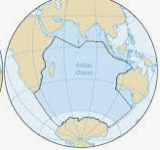
GDP growth forecasts
 | World | Asia | AEs | EMDEs | China | Japan | India | Korea | Australia | ASEAN | PICs
2022 | 3.4 | 3.8 | 1.8 | 4.4 | 3.0 | 1.1 | 6.8 | 2.6 | 3.7 | 5.7 | 1.0
2023 | 2.8 | 4.6 | 1.6 | 5.3 | 5.2 | 1.3 | 5.9 | 1.5 | 1.6 | 4.6 | 3.9
Revisions since Oct. 2022 WEO | 0.1 | 0.3 | -0.4 | 0.4 | 0.8 | -0.3 | -0.2 | -0.5 | -0.3 | -0.1 | -0.4
2024 | 3.0 | 4.4 | 1.7 | 5.0 | 4.5 | 1.0 | 6.3 | 2.4 | 1.7 | 4.9 | 3.6
Revisions since Oct. 2022 WEO | -0.2 | -0.2 | -0.2 | -0.2 | 0.0 | -0.3 | -0.5 | -0.3 | -0.1 | -0.2 | -0.1
Source: WEO April 2023.

Slide 4
Inflation could be stickier than expected
Core inflation is increasingly becoming the main driver of inflation…
…while monetary tightening appears to have paused in many countries
Source: Haver Analytics; and IMF staff calculations.
Note: Core refers to CPI basket excluding food and energy, fuel, and transport. The exact categories used in the decomposition of these categories varies across countries. AE Asia includes AUS, HKG, KOR, MAC, NZL, SGP, TWN. EMDE Asia includes IDN, IND,MYS, PHL, THA. Other AE include BEL, CAN, CHE, DEU, FRA, GBR, ITA, NLD, SWE, USA. Other EMDE include BRA, CHL, COL, HUN, MEX, ZAF.

Slide 5
Limited spillover from global financial turmoil
Spillovers from global financial stress have been limited so far…
…and Asian currencies have appreciated against the US dollar
Change in bank equity prices
(In percent)
Change in exchange rates against USD
(In percent)
Source: Bloomberg Finance L.P and IMF staff calculations.
Note: Data as of April 12, 2023.
Source: Bloomberg Finance L.P. and IMF staff calculations
Note: Data as of April 12, 2023.

