Slide 1

Regional Economic Outlook
Middle East, North Africa, Afghanistan and Pakistan
October 31, 2017

Slide 2
Roadmap
Securing Higher and More Inclusive Growth
Outlook and Risks
Maintaining Macrofinancial Stability
Key Takeaways and IMF’s Role

Slide 3

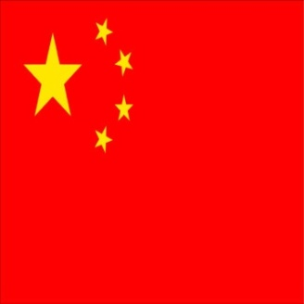

The global recovery is strengthening
 | World | U.S. | Euro | Emerging | China
 |  |  | Area | markets
2016 | 3.2 | 1.5 | 1.8 | 4.3 | 6.7
2017 | 3.6 | 2.2 | 2.1 | 4.6 | 6.8
2018 | 3.7 | 2.3 | 1.9 | 4.9 | 6.5
Note: Upward revisions to growth relative to April 2017 WEO are highlighted in green; downward revisions are highlighted in red.

Slide 4
Commodities outlook remains subdued despite global growth momentum and OPEC-led agreement
Oil Price Assumptions
(APSP¹, U.S. dollars a barrel)
Metal Price Assumptions
(Index, 2005=100)
▬ Current
— April 2017 WEO Update
Source: IMF staff calculations.
Note: REO = Regional Economic Outlook: Middle East and Central Asia; WEO = World Economic Outlook. ¹APSP = Average Petroleum Spot Prices; Average of U.K. Brent, Dubai Fateh, and West Texas Intermediate crude oil prices.

Slide 5
Geopolitical tensions and conflicts continue to generate humanitarian and economic costs
Countries of origin: (Refugees per 1,000 population)
 |  | > 200
 |  | > 10
 |  | > 0.5
Host countries: (Refugees per 1,000 population)
 |  | > 200
 |  | > 10
 |  | > 0.5
Sources: World Bank, UNHCR, and Microsoft Map Land.
Note: The country names and borders on this map do not necessarily reflect the IMF's official position.

Slide 6
Growth in MENAP to remain subdued … but important differences across oil exporting and importing countries
Real GDP Growth
(Percent)
Total real GDP growth 2000-10
Sources: National authorities and IMF staff calculations.
Notes: Regional aggregates are calculated using PPPGDP weights. Averages across years are calculated using simple averages.
6

Slide 7
Risks remain tilted to the downside
Global Risks
MENAP
Risks
Improved economic conditions in main
trading partners
New integration initiatives (e.g., Belt and Road Initiative, Compact with Africa)
Upside
Rapid tightening of global financial conditions
Geopolitical risk
and
conflicts
Downside
Shift towards inward-looking policies
Slow implementation
of structural reforms
7

Slide 8
Roadmap
Securing Higher and More Inclusive Growth
Outlook and Risks
Maintaining Macrofinancial Stability
Key Takeaways and IMF’s Role

Slide 9
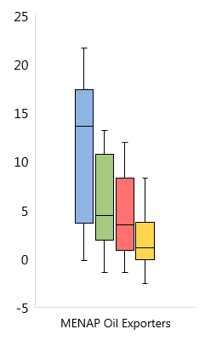
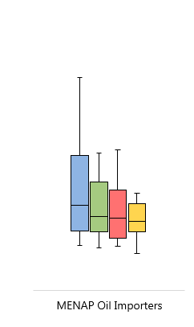
Continued—and in some cases accelerated—fiscal consolidation is important to maintain sustainability
Fiscal Deficit
(Percent of GDP)
Public Debt and Interest Payments
(2017)
■ 2016 ■ 2017 ■ 2018 ■ 2019-22
— Median □ Inter-quartile range T Range
Sources: World Economic Outlook and IMF staff calculations.
Note: Yemen excluded. For 2017, Yemen’s public debt is estimated to be 83 percent of GDP and interest payments are estimated to be 70 percent of government revenues. EM refer to a sample of 153 emerging market and developing countries (EMDE).
Note: Libya is excluded from MENAP Oil Exporters aggregate.

Slide 10
External deficits declining gradually, supported by fiscal consolidation and improved global conditions
Current Account Deficits
(Percent of GDP)
Sources: National authorities and IMF staff calculations.

Slide 11
Increased inflation due to one-off factors, but improved monetary policy frameworks needed in many countries
Overall Consumer Price Indices
(Year averages, percent change, year-on-year)
MENAP oil exporters
MENAP oil importers
Sources: National authorities; and IMF staff calculations.
Note: MENAP = Middle East, North Africa, Afghanistan and Pakistan; GCC = Gulf Cooperation Council. Country-specific weights correspond to purchasing power parity adjusted GDPs.

Slide 12
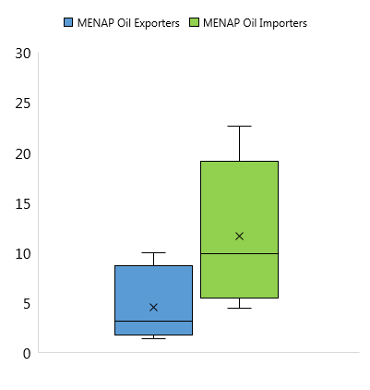
Strong and resilient financial sectors are needed to support growth and diversification
Private Credit Growth
(Percent, year-over-year)
Non-Performing Loans
(Percent of total loans, end of period)
— Median X Mean □ Inter-quartile range
T Range • Outlier
Sources: National authorities; and IMF staff calculations.

Slide 13
Roadmap
Securing Higher and More Inclusive Growth
Outlook and Risks
Maintaining Macrofinancial Stability
Key Takeaways and IMF’s Role

Slide 14
Securing higher and more inclusive growth is critical to all MENAP countries
Youth Unemployment Rate
(Percent)
Projected Labor Force Increase
(Millions of people, cumulative)
Labor Force in 2017 (estimate):
GCC: 26 millions
Non-GCC MENAP Oil Exporters: 61 millions
MENAP Oil Importers: 155 millions
Sources: 2016 International Labor Organization; World Bank; and IMF staff estimates.
Sources: ILO.

Slide 15
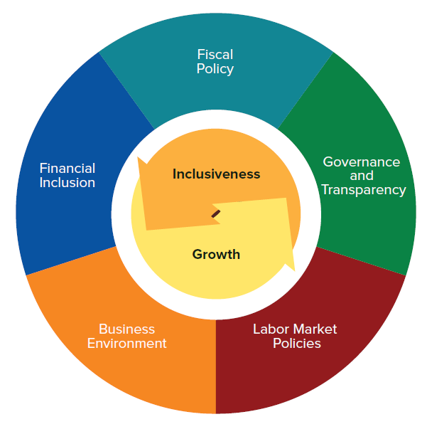
Multiple policy levers are needed to spur higher and more inclusive growth
Five Pillars of Inclusive Growth

Slide 16
Structural reforms need to be accelerated
Ease of Doing Business 2014-17
(Current ranking and change in distance to frontier)
Change in distance to frontier from 2014 to 2017:
Current ranking:
Improving
Worsening
 |  | Top 25 %
 |  | Top 50 %
 |  | Top 75 %
 |  | Bottom 25 %
Source: World Bank Doing Business Indicators. Non-GCC includes Iran and Algeria.

Slide 17
Greater trade integration would capitalize on global growth momentum; more export diversity will help
Export Diversity Index, 2014 ¹
(0 to 1, higher is more diverse)
Source: IMF Diversification database; and IMF staff calculations
¹ 2014 is latest available year for the diversity index
Note:; EMDE = Emerging and developing economies; Other oil importers (OI) include Bangladesh, Cambodia, Vietnam. Other oil exporters (OE) include Malaysia, Mexico, and Indonesia. Diversity index rebased to be from 0 to 1, and is equal to a Theil index of export concentration.

Slide 18
Adoption of financial technology would boost growth and inclusiveness, but risks need to be managed
Account at a Financial Institution
(Percent of adults, age 15+)
Access to Finance
(Percent)
Source: World Bank – Global Financial Inclusion Database.
Note:; EMDE = Emerging and developing economies; Other oil importers (OI) include Bangladesh, Cambodia, Vietnam. Other oil exporters (OE) include Malaysia, Mexico, and Indonesia
Source: World Bank, Enterprise Survey.
Note: Tunisia data is for 2014.
18

Slide 19
Roadmap
Securing Higher and More Inclusive Growth
Outlook and Risks
Maintaining Macrofinancial Stability
Key Takeaways and IMF’s Role

Slide 20
Key takeaways
Regional outlook subdued, despite global recovery
Important downside risks remain
The focus on fiscal consolidation and strengthening monetary policy frameworks should continue
Policy makers need to ensure financial sectors remain strong and resilient
Structural reforms should be accelerated, and institutional frameworks enhanced
Trade integration and adoption of financial technology offer important opportunities for growth

Slide 21
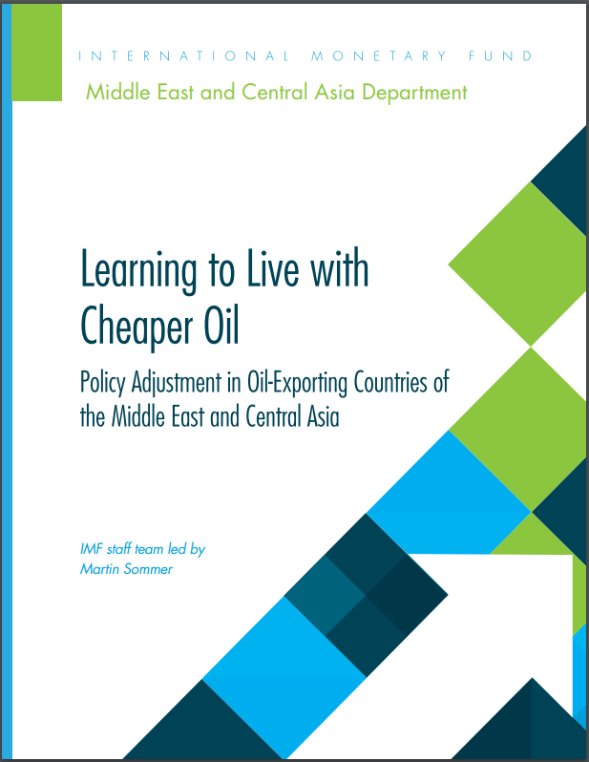



IMF’s role
Policy Analysis
Capacity Development
Bilateral Engagement
Regional Cooperation

