Slide 1
A Primer on Bank Capital Regulation: Theory, Empirics, and Policy
Shekhar Aiyar, Charles W. Calomiris
and Tomasz Wieladek *
De Nederlandsche Bank
June 12, 2013
* Opinions expressed in this presentation should not be attributed to the International Monetary Fund or to the Bank of England.

Slide 2
Theory
1. What is the role of equity in a bank’s financing structure?
Ex post shock absorber
Ex ante incentives for risk management
(Calomiris-Kahn 1991, Holmstrom-Tirole 1997, Calomiris-Heider-Hoerova 2014)

Slide 3
Theory (cont’d)
2. What is the role of setting minimum equity-to-asset ratio requirements as part of prudential bank regulation?
Externalities of reducing failure risk (signaling or interconnectedness)
Safety net subsidies (Merton 1977, etc.)
Agency conflicts with shareholders

Slide 4
Theory (cont’d)
3. What are the social benefits, and what are the social costs, of raising minimum bank equity-to-asset ratios?
Benefit is greater bank stability.
Costs of issuing or avoiding (Myers-Majluf 1984).
Agency costs of risk management and effort if set too low (Holmstrom-Tirole 1997), or too high (Kashyap-Rajan-Stein 2008).
Loan-supply contraction (Bernanke 1983, etc.), but conceivable exceptions under debt overhang.

Slide 5
Theory (cont’d)
Common principles these models illustrate:
Safety nets and interest deductions are not the only drivers of bank capital structure choice.
Firms costs of raising capital not equal to expected returns to investors. Modern capital structure theory is all about reasons they are different.

Slide 6
Empirics
4. What sorts of evidence exist regarding these benefits and costs?
Evidence on benefits mixed (implementation uneven): Berger-Bouwman 2013 vs. Barth-Caprio-Levine 2006; Aiyar-Calomiris-Wieladek 2014
Adverse-selection costs large even in response to equity ratio hike Cornett and Tehranian (1994).
Credit-supply contraction can be severe: Loan losses (Peek and Rosengren 2000, etc.); Cap Req increase (Aiyar et al., Jimenez et al., Brun et al.)
History (Calomiris-Wilson; Calomiris-Carlson: These effects are not driven only by taxes and safety nets!

Slide 10
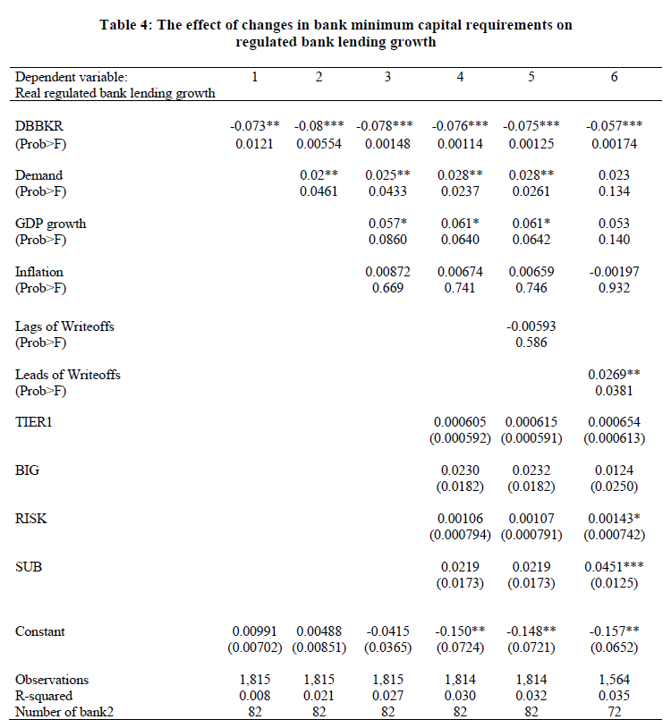

Slide 11
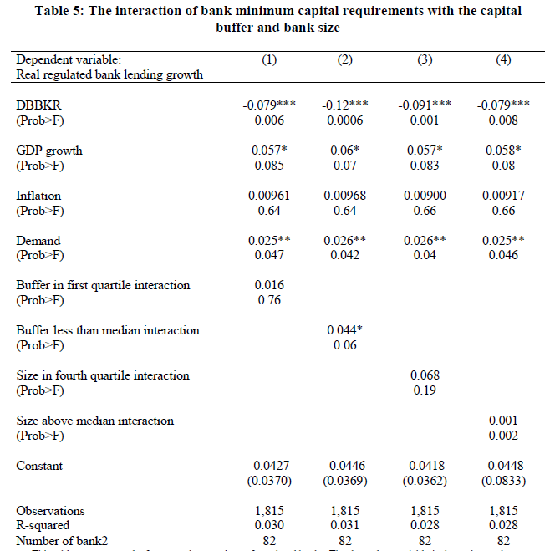

Slide 12
Geographical Distribution of UK Banks’ Cross-Border Lending (2006)

Slide 13
Heterogeneous Effects
 | (1) | (5) | (8)
UK regulated banks’ cross-border lending growth
Change in capital requirement ratio (DBBKR) (summed lags) | -6.942*** | -4.951* | -5.693*
Core Market*DBBKR | 6.707* | 7.608** | 9.176
Periphery Market* DBBKR | 7.291 | 6.760 | 6.440
Core Market | 9.784*** | 10.040*** | 9.951***
Periphery Market | -6.432*** | -6.412*** | -6.207***
Home Country |  | -5.637*** | -5.281***

Slide 14
Cumulative Changes in Balance Sheet Variables From a 100bp Increase in Capital Requirements
Notes: The figure shows cumulative percentage changes in domestic private sector loans, cross-border loans, risk-weighted assets and the cumulative pp change in the capital buffer, in the three quarters following a change in capital requirements (at t0). The lines show the median response across banks, to changes in capital requirements, normalised to a 100bp increase.

Slide 15
Empirics (cont’d)
5. Are bank equity ratios too low for global US and European banks?
Measure on a risk-adjusted basis, where default risk is key criterion.
Evidence that it is too high: Crisis propensity (Laeven-Valencia 2013), SRISK measures (Acharya et al. 2013), Ignatowski and Korte (2014)
Contrast with disciplined environment such as NYC banks in 1930s (Calomiris-Wilson 2004), Argentine banks in 1990s (Calomiris-Powell 2001)

Slide 16
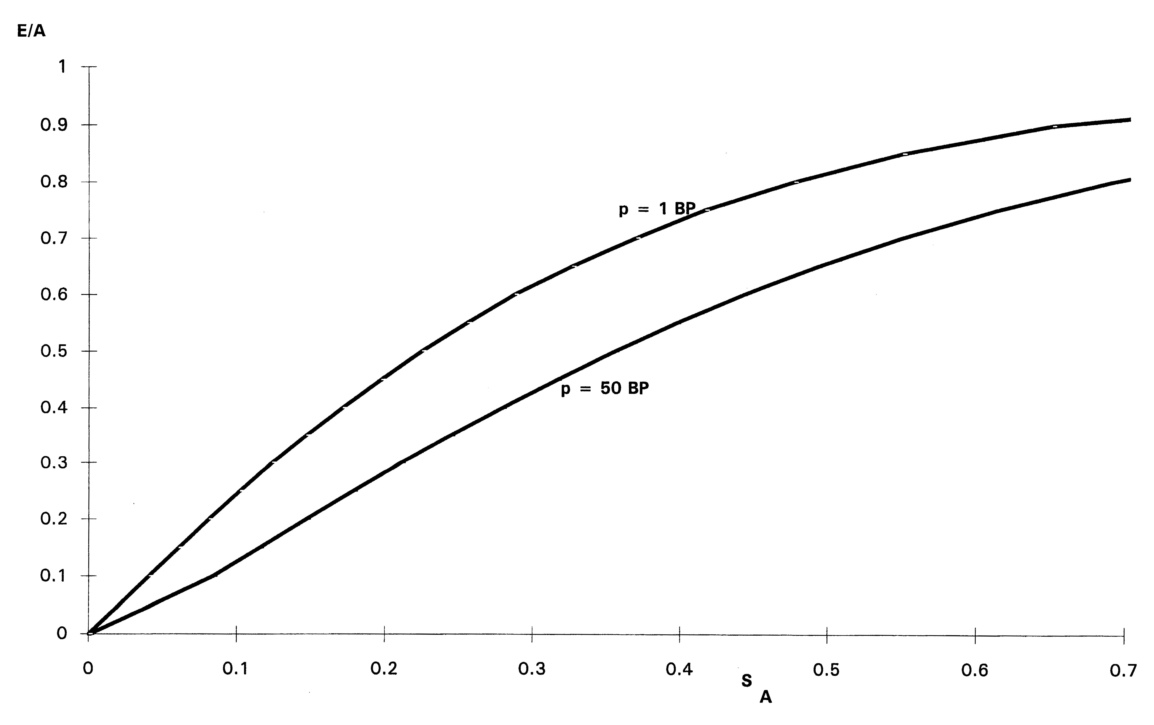
Two Ways to Skin Cat of Default Risk

Slide 18
Calomiris-Powell (Argentina)
Dep Var: Argentina’s Quarterly Deposit Growth
Regressor Coefficient Stand.Error
Equity Ratio 0.277 0.074
Loan Int. Rate -0.254 0.121
Loans/Cash -0.0032 0.0007
Sample period: 1993:3-1999:1
Number of Observations: 1,138
Adjusted R-Squared: 0.31

Slide 19
Pitfalls of Book Equity Regulation
6. What are the shortcomings of using book equity ratios as prudential tools?
Unrecognized losses (Huizinga-Laeven 2009)
Value beyond tangibles (Calomiris-Nissim 2014)
Endogenous risk choice (Haldane 2013)

Slide 20
Solutions To Avoid Pitfalls
7. What combination of additional policies should accompany a rise in minimum equity ratio requirements?
Improvements in credibility of risk measurement (Calomiris 2011)
CoCos based on high market ratio triggers to incentivize maintenance of high equity ratios (Calomiris-Herring 2013)
Cash (not “liquidity”) requirements to improve ex post buffer and ex ante incentives (Calomiris-Heider-Hoerova 2014)

Slide 21
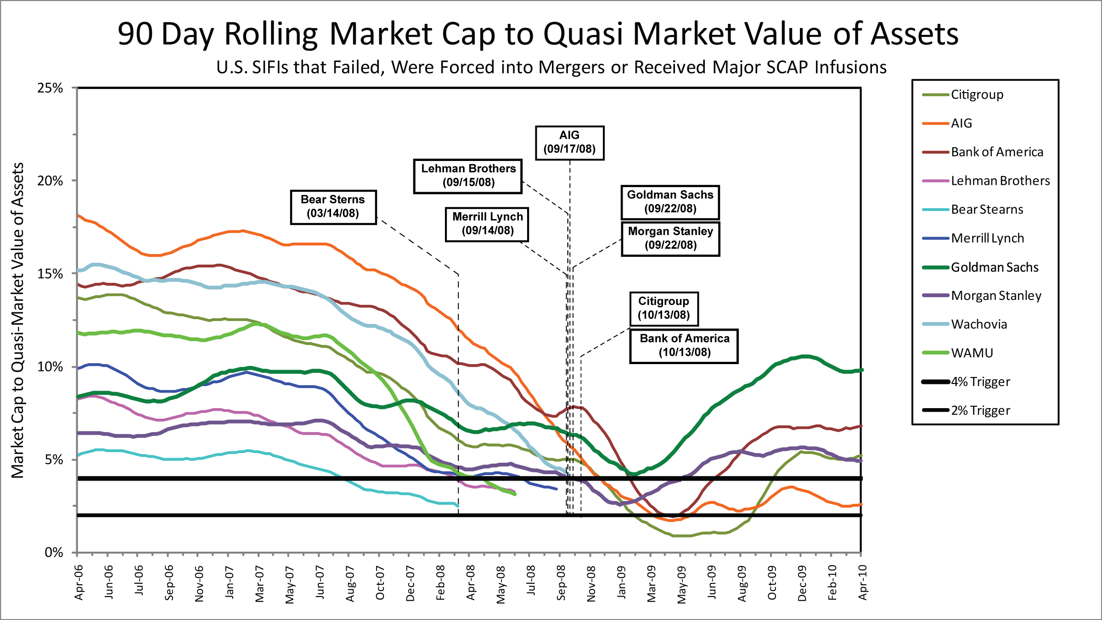

Slide 22
How To Harness Market Information?
Key point #1: CoCos should not be used as “bail in” instruments close to insolvency; rather to keep banks far away from insolvency.
Key point #2: CoCos are not an alternative to book equity requirements, but as a means of ensuring that higher book equity requirements are meaningful.
Key point #3: CoCos will only work if they rely on market triggers, and those will only be helpful if they are set at high ratios of market equity value relative to assets.

Slide 23
Solutions To Those Problems (cont’d)
8. How should cash or liquidity requirements be integrated with equity requirements?
Minimum (remunerative) cash ratio requirement alongside minimum capital ratio requirement and CoCos requirement, which along with CoCos helps to ensure appropriate combination of capital and asset risk (Calomiris-Heider-Hoerova 2014; Calomiris 2012).

Slide 24
Capital Req’s as a Macro-Prudential Tool
9. What are objectives and pitfalls of capital requirements as a macro-prudential tool?
Distracts from more important sources of trouble (micro-prudential, monetary policy)
Parameter uncertainty of gross effects (Aiyar et al. 2014a, 2014b, 2014c), and of net effects due to “leakage” (Aiyar et al. 2014a, 2014b).
Harm to monetary policy predictability,accountability.
Costs of forebearance
=> Use rarely and predictably in response to credit booms (comply or explain rule)

Slide 25
Table 6: Leakages from Bank Minimum Capital Requirements
Dependent variable: Real branch lending growth |  | (1) | (2) | (3) | (4) | (5) | (6)
Regulated bank lending growth |  | -3.18*** | -2.83*** | -3.14** | -2.88** | -2.74** | -3.27**
Demand |  |  | 0.082** | 0.09** | 0.056 | 0.066 | 0.061
Leads of changes in Writeoffs |  |  |  | 0.621 | 0.664 | 0.71* | 0.701
GDP growth |  |  |  |  | -0.20* | -0.19* | -0.24*
Inflation |  |  |  |  | -0.13*** | -0.14*** | -0.14**
Home Country KR |  |  |  |  |  | -1.550 | -2.017
CAPITAL |  |  |  |  |  | -0.156* | -0.186
OFFICIAL |  |  |  |  |  | 0.137* | 0.126
Home Country GDP growth |  |  |  |  |  |  | 0.00159
Home Country Inflation |  |  |  |  |  |  | -0.0132*

Slide 26
Asymmetric Loan-Supply Responses
Subsidiary Positive DBBKR | 0.567*** | 0.595*** | 0.567*** | 0.619*** | 0.572***
Subsidiary Negative DBBKR | -0.207 | -0.083 | -0.086 | -0.142 | -0.086

Slide 27
Table 4 – Comparing Affiliated and Non-Affiliated Branch Leakages
Dependant Variable: Lending Growth of Foreign Branch
 |  | (2) |  | (4)
 |  | Branch-specific Reference Group Excludes Affiliated Subs of branch |  | Branch-specific Reference Group Excludes All Affiliated subs
Subsidiary DBBKR |  | 0.30** |  | 0.32**
Group Demand |  | 0.12*** |  | 0.12***
Unaffiliated Branch Demand |  | 0.062*** |  | 0.061**
Reference DBBKR |  | 0.24*** |  | 0.20***

Slide 28
Conclusion
Raising minimum capital ratio requirements can has social benefits and social costs.
Currently, there is a good case to be made for net benefits from a substantial increase in requirements (say, to 10% of assets).
To be effective, book equity ratio regulations need to be combined with other tools that make them more effective and credible (CoCos, cash requirements).
Macro-prudential regulation is a risky distraction, best reserved for cooling severe credit booms.

