Slide 1
The political economy of structural reforms:
Lessons from Europe
André Sapir
University Professor, Université Libre de Bruxelles, and Senior Fellow, Bruegel
Presentation prepared for the Seminar on Small Middle-Income Countries—Raising the Bar
Organized by the National Bank of Botswana and the International Monetary Fund
Gaborone, 29 January 2016

Slide 2
The EU as a laboratory
With 28 members, lots of diversity in performance
  Growth trajectories, GDP per capita
From accession members share important product market policies which have fostered crucial structural reforms and convergence
  Single market: free trade inside the EU
  Trade policy: liberal trade with countries outside the EU
  Competition policy: antitrust and state aid control
But members have significant diversity in other relevant structural policy areas which explains their diversity in performance
  Regulatory and governance quality
  Labour market and social policies

Slide 3
From 6 to 28 members, with increasing heterogeneity

Slide 4
Convergence in the 11 Central and Eastern European Countries who joined the EU in/after 2004
(GDP per capita at PPP, EU15 =100)
Start of negotiations
Simple average for the 11 countries
40 41 49 64

Slide 5
But the EU15/US gap is not closing – Large countries
(GDP per capita at PPP, US =100)
78 ITALY 71 63

Slide 6
Escaping the middle income trap
GDP per capita growth trajectories, 1950-2010
(selected EU countries)
Escaped by 2015
Data source: Felipe (2012)
EU accession

Slide 7
Despite convergence, GDP per capita still varies a lot
(EU28, excl. Lux, PPP$, 2010)

Slide 8
GDP per capita strongly correlates with regulatory quality EU28 (excl. Lux)
GDP per capita, 2010
IT
Correlation coefficient
= 0.77
EL
EE
Regulatory quality, 2010

Slide 9
Same result with WB governance indicator
EU27 plus neighbours
Source: ECFIN presentation on convergence

Slide 10
Reform process: EU and national levels
EU level reform process worked very well before EU entry and delivered strong results in terms of convergence after EU entry
untry specific EU recommendations (similarOVERVIEW TABLE OF 2015 CSR
Ultimately the EU level reform process can only act as a facilitator
olitically painful reforms must be undertaken by national policymakers accountable to their national public opinio

Slide 11
Reform and convergence in Europe’s transition countries
Pre- and post-entry effects
Source: IMF presentation on 25 years of transition

Slide 12
Reform process: EU and national levels
U level reform process worked very well before EU entry
EU level reform process has been more difficult otherwise
  League tables and peer pressure are helpful, but…
  EU Country specific recommendations (similar to OECD’s Going for Growth and IMF’s Article IV recommendations) also helpful, but…
  Typically more effective in small than in large countries, and in more than less open economies
  SEE OVERVIEW TABLE OF 2015 CSR
Ultimately the EU level reform process can only act as a facilitator
olitically painful reforms must be undertaken by national policymakers accountable to their national public opinions

Slide 13
Overview of 2015 country specific recommendations
21 18 14 10 11 6 21 8 11 13 5 13 6 19

Slide 14
Reform process: EU and national levels
EU level reform process worked very well before EU entry
EU level reform process has not worked very well otherwise
  League tables and peer pressure are helpful, but…
  Country specific EU recommendations (similar to OECD’s Going for Growth and IMF’s Article IV recommendations) also helpful, but…
  Typically more effective in small than large EU countries, and in more than less open economies
Ultimately the EU level reform process can only act as a facilitator
Responsibility for politically painful reforms rests with national policymakers accountable to their national public opinions

Slide 15
How to make reform happen - OECD’s Going for Growth
Government leadership and cohesion, based on a strong democratic mandate
Policy design backed by solid research and analysis, and effective communication by government
Successful structural reforms take time and require persistence
Source: OECD (2015b)

Slide 16
Bold reforms also require a sense of national urgency that the status quo is not viable
EU accession acted as a successful anchor for needed reforms
  Southern accession: Greece, Portugal, Spain in the 1980s
  Eastern accession: 11 CEECs since 2004
In other situations, reform followed crises, e.g.
  NL’s 1980s “Polder Model” reforms to deal with “Dutch disease”
  IE’s late 1980s “Tallaght Strategy” to deal with deep crisis
  SE’s mid-1990s reforms during a severe financial and fiscal crisis
  DE’s 2003-5 Hartz reforms to deal with high unemployment
  FR: no bold reform so far…
Sovereign debt crises have led to important reforms, e.g.
  Greece, Ireland, Italy, Portugal, Spain

Slide 17
Labour market reforms are politically the most difficult
But they are key in EU15: Going for Growth priorities
(In percent of the total number of policy priorities of the geographic area, 2015)
Source: OECD (2015a)

Slide 18
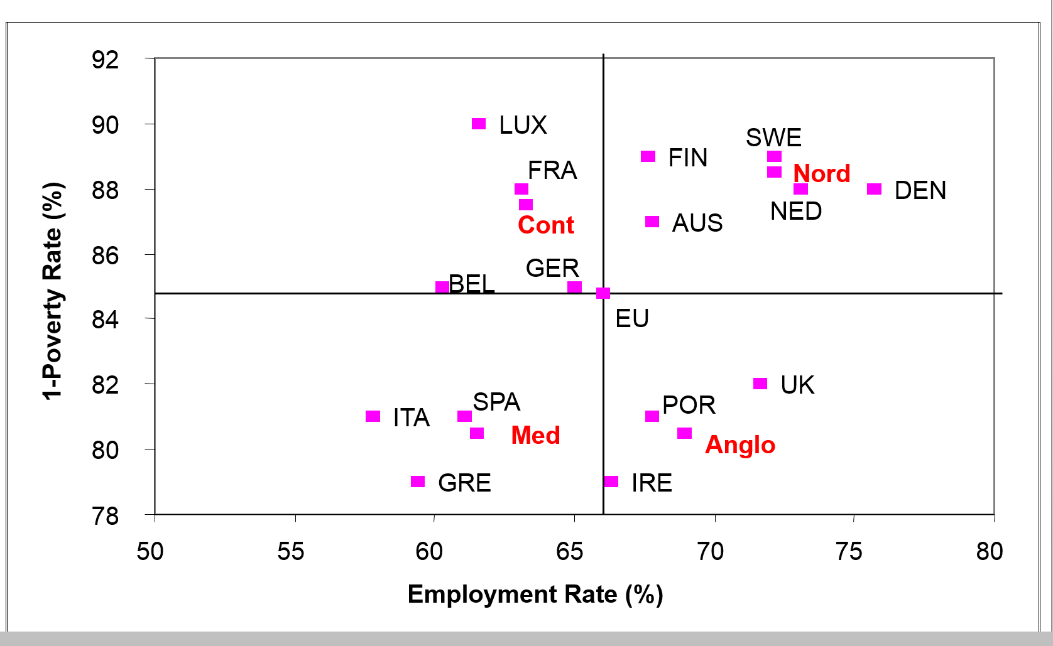
Big diversity of labour market & social models, 2004
EU15
Persons at risk of poverty is after social transfers
EU is the simple average of EU15 countries

Slide 19
Big diversity of labour market & social models, 2004
EU15
EQUITABLE
NOT EFFICIENT
EQUITABLE
EFFICIENT
NOT EQUITABLE
NOT EFFICIENT
NOT EQUITABLE
EFFICIENT
Persons at risk of poverty is after social transfers
EU is the simple average of EU15 countries

Slide 20
EU countries need to modernize their LM&S models
To deal with the “Great Transformation”
  Globalization of activity – shift from advanced to emerging economies
  Technological change – digitization
  Ageing of the population
Flexibility is key, but security is also very important
Social models should be seen as comprising two components:
  Employment and social policy
  Education/training policy

Slide 21
Lots of labour reforms, especially in crisis countries
2000-07 and 2008-13
Source: European Commission, LABREF database

Slide 22
Some changes in LM&S, 2014 vs. 2004
EU15
NED
FIN
DEN
FRA
AUS
SWE
BEL
LUX
UK
GER
ITA
POR
SPA
GRE
The Nordics are still Nordics
The Meds are still Meds BUT…
Changes of category: 2/4 Continentals; 3/3 Anglo-Saxons (IRE n.a.)

Slide 23
Some final remarks
The EU can only act as a facilitator, but in some dimensions (Single Market) and some instances (accession) it can be crucial
“Reform is ultimately a domestic political business where trade offs are being made between economic efficiency, social goals and the way power and income are distributed in a society” (Fatas, 2015)
Timing and design of reforms are key
  Reform fatigue sets in fast, esp. if communication/leadership weak
  Although macroeconomic crises may/often trigger reform (see Agnello et al., 2015) the right macroeconomic policies are important to ensure that reforms succeed

Slide 24
Readings
Agnello, Luca, Vitor Castro, João Tovar Jalles and Ricardo M. Sousa (2015). “What determines the likelihood of structural reforms?”, European Journal of Political Economy, Vol. 37, 129–145.
Fatas, Antonio (2015). “The agenda for structural reform in Europe”, CEPR Discussion Paper No. 10723. London: CEPR.
Felipe, Jesus (2012). “Tracking the Middle-Income Trap: What is It, Who is in It, and Why?” ADB Economics Working Paper No. 306, Asian Development Bank
OECD (2015a). “Structural reforms in Europe: achievements and homework”, Better Policies Series. Paris: OECD.
OECD (2015b). Economic policy reforms 2015: going for growth. Paris: OECD.

