Slide 1

Small Middle-Income Countries in Sub-Saharan Africa: Taking Development to the Next Level Min Zhu IMF Deputy Managing Director Grand Palm Hotel, Gaborone, Botswana January 29, 2016

Slide 2
Outline
I. The external environment
II. Successes and Challenges
III. Rethinking growth strategies and policies

Slide 3
Outline
I. The external environment
II. Successes and Challenges
III. Rethinking growth strategies and policies

Slide 4
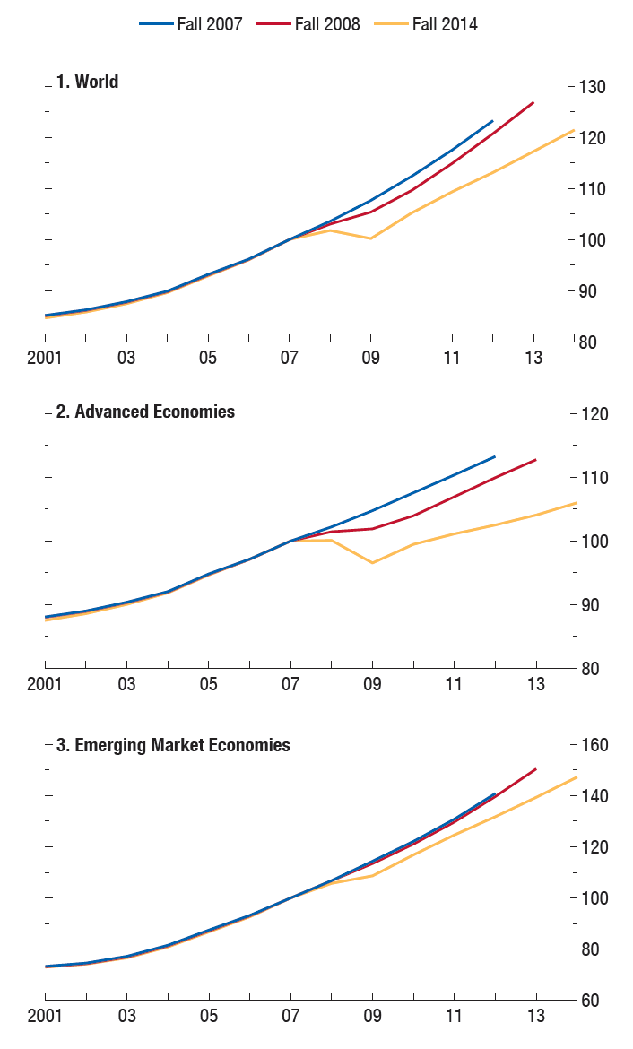
The Legacy of the Crisis: Output Compared to Pre-crisis Expectations (percent, 2007=100)

Slide 6
World FDI
(in percent of World GDP)

Slide 7
GDP vs. Trade
(average annual growth in percent)

Slide 8
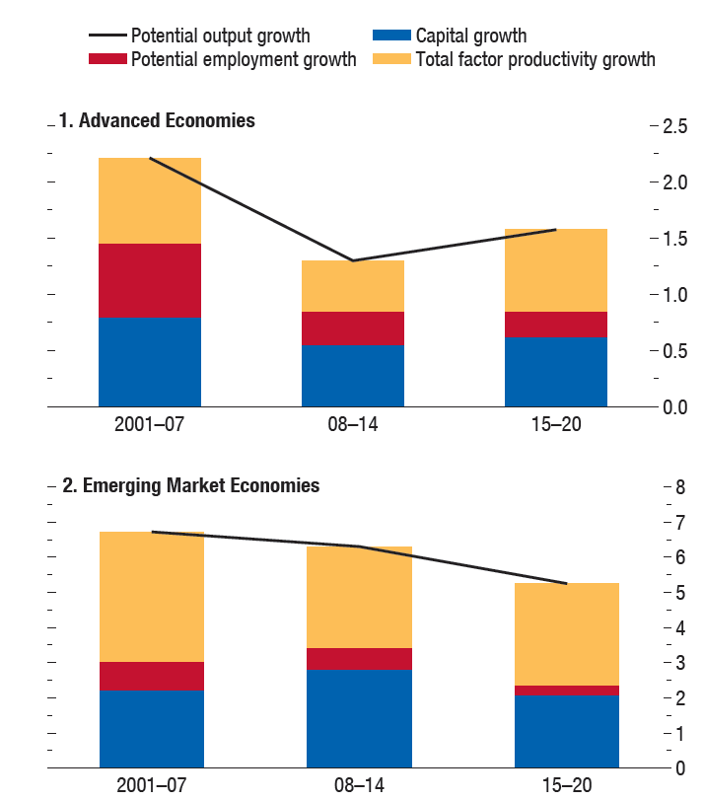
Evolution of Potential Output Growth (percent)

Slide 9
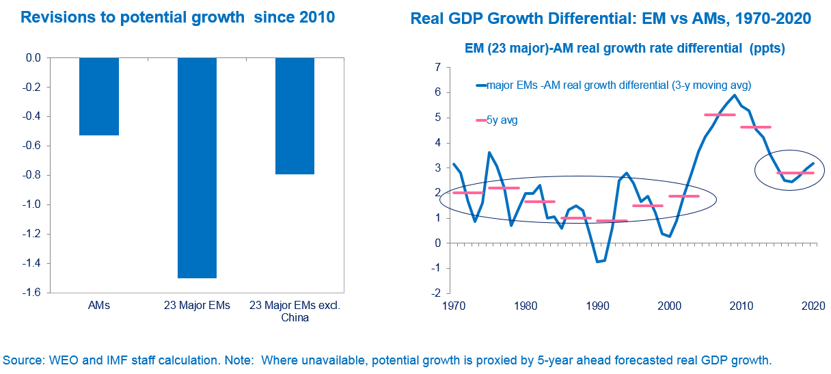
EM Potential Growth

Slide 10
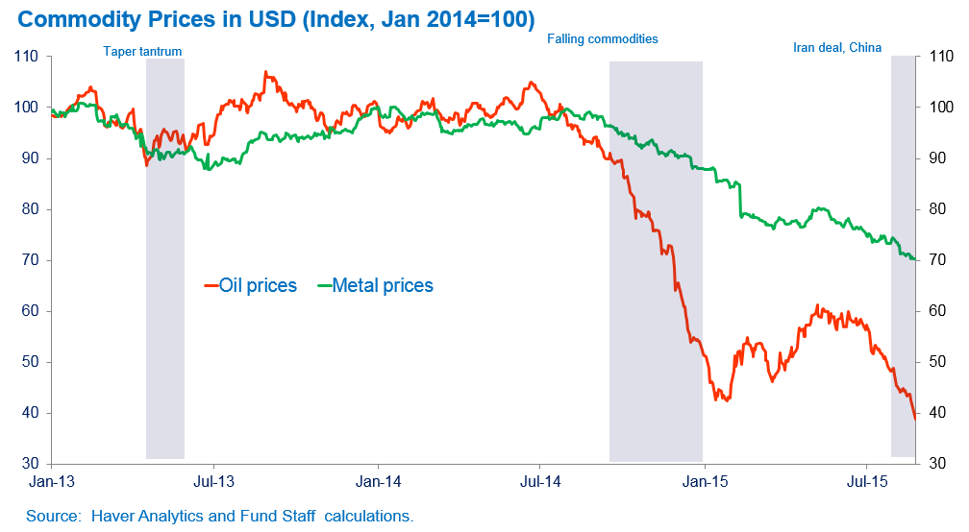
Commodity Prices Fall

Slide 11
Commodity Prices Fall
Selected Commodity Prices, 2012–Nov 2015
Source: IMF, Commodity Price System and Global Assumptions.
Source: IMF, World Economic Outlook database.

Slide 12
External financing conditions are tightening
Sovereign Bond Spreads
(EMBIG spreads, basis point change since October 2014)
Source: Bloomberg. Note: Data as of January 4, 2016. “Emerging markets” average includes Argentina, Brazil, Bulgaria, Chile, Colombia, Hungary, Malaysia, Mexico, Peru, Philippines, Poland, Russia, South Africa, Turkey, and Ukraine.

Slide 13
Magnified for BLNS from spillovers from S. Africa
Exposure from exports to SA
And lower SACU revenues
Exports to South Africa from Neighboring Countries, 2014 (Percent of GDP)
BLNS Countries: Customs Revenues Payments.
Tanzania
Malawi
Comoros
Angola
Zambia
Mozambique
Namibia
Zimbabwe
Madagascar
Less than 1%
1% to 2%
Botswana
Mauritius
2% to 5%
5% to 20%
South Africa
Swaziland
Greater than 20%
Lesotho
Source: IMF, Direction of Trade Statistics.
Source: Country authorities.

Slide 14
Three specific megatrends to impact on SMICs
Climate change
Technology
Demographics

Slide 15
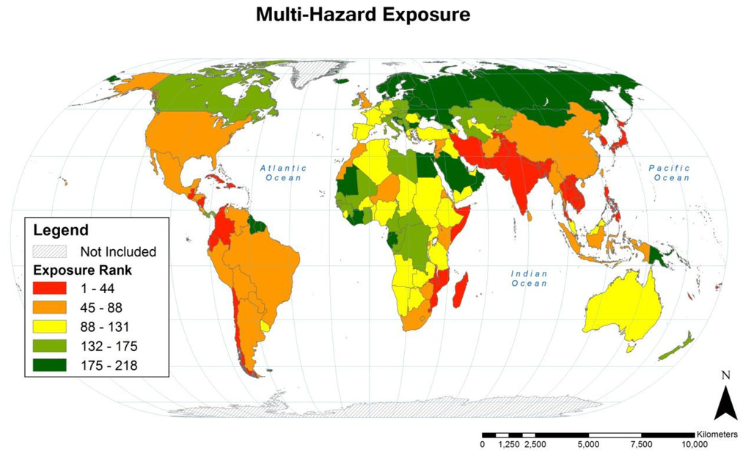
Megatrend (1): Climate change emphasizes the need to enhance resilience, particularly for island states
Source: Christenson et al. (2014), Climate-Related Hazards: A Method for Global Assessment of Urban and Rural Population Exposure to Cyclones, Droughts, and Floods, Int. J. Environ. Res. Public Health 2014, 11(2)

Slide 16
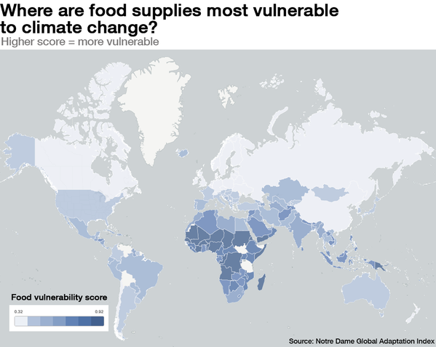
Megatrend (1): Climate: Poor most vulnerable

Slide 17
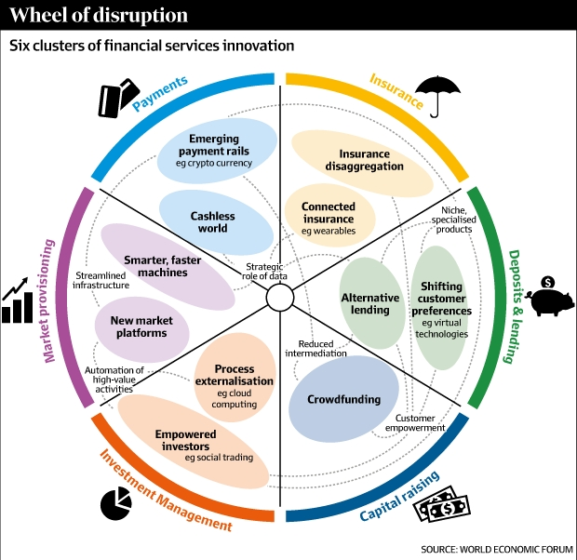
Megatrend (2): Technology will change conventional business practices

Slide 18
Megatrend (3): Properly harnessed, SSA’s demographic potential can be transformative
Change in Global Working-Age Population
Source: IMF (2015), Harnessing the demographic dividend in sub-Saharan Africa, Regional Economic Outlook, Spring 2015.

Slide 19
Outline
I. The external environment
II. Successes and challenges
III. Rethinking growth strategies and policies

Slide 20
Sustained growth
Sub-Saharan African Small Middle Income Countries: Real GDP Growth
Source: IMF, World Economic Outlook database.

Slide 21
Sustained increase in GDP per capita
Sub-Saharan African SMICs: GDP per capita (US$, PPP)
But growth moderation has stalled convergence
Source: IMF, World Economic Outlook database.

Slide 22
Domestic challenge: Foster economic diversification
Low export diversification
High share of services, reflecting government expansion in most cases
Export Diversification Index
(Lower number = Greater diversification)
Composition of GDP, 2014
Source: UNCTADstat, World Economic Outlook database.

Slide 23
Domestic challenge: Job creation
Unemployment Rate, Average 1995–2013
Source: World Bank, World Development Indicators.

Slide 24
Domestic challenge: Manage public employment and wage bill
Share of Public Employment, Average 1995–2012
Wage Bill, 2014
Source: ILOPE. Note: Cabo Verde data is for 2014 only.
Source: IMF, World Economic Outlook database.

Slide 25
Domestic challenge: Addressing infrastructure gap
Big increases in public investment not necessarily translating in improved infrastructure quality
Government capital stocks stagnant in most countries following investment slowdown
Source: IMF, World Economic Forum. Note: Each point corresponds to the average of four time periods (1996-00; 01-05; 06-10; and 11-13).
Source: IMF Investment and Capital Stock Dataset, 2015.

Slide 26
Domestic challenge: Improve Human Development
Source: United Nations Development Programme, Human Development Report, 2015.

Slide 27
Domestic challenge: Inclusive growth
Poverty and Income Inequality, Latest Available
Source: World Bank, World Development Indicators.

Slide 28
Outline
I. Successes and Challenges
II. The changing external environment
III. Rethinking growth strategies and policies

Slide 29
Three key challenges to graduate to advanced economy status
Dealing with external headwinds
Adapting to global trends
Overcoming domestic challenges

Slide 30
Experiences (1): Countries that graduated to AE status had more effective governments
Government effectiveness varies significantly
And not necessarily correlated to size of government spending
Government Effectiveness Index, 2014
Government Expenditure, 2014
Source: World Bank, Worldwide Government Indicators.
Source: IMF, World Economic Outlook database.

Slide 31
Experiences (2): Countries that graduated to AE status created a more enabling environment for the private sector
Stronger investor protection in advanced economies
As well as more credit to the private sector
Strength of Investor Protection Index, 2014
Credit to the Private Sector, 2014
Source: World Bank, Doing Business Indicators.
Source: World Bank, World Development Indicators.

Slide 32
Experiences (3): Countries that graduated to AE status had more inclusive growth
Poverty Headcount at $1.25 a Day (PPP), Latest Available
Unemployment Rate, 2013
Source: World Bank, World Development Indicators.

Slide 33
Rethinking growth strategies and reversing the decline in TFP
Sub-Saharan African Small Middle-Income Countries: Total Factor Productivity, Contribution to Growth
Sources: Penn World Tables; and IMF staff calculations.

Slide 34
Tailoring reforms to stage of economic development
Structural Reforms with Highest Productivity Payoffs within Each Country Group
MICs
Source: IMF (2015), Structural Reforms and Macroeconomic Performance - Initial Considerations for the Fund, Policy Paper, Washington DC.

Slide 35
Main reform priorities
Source: Survey of IMF SMICs Mission Chiefs, December 2015.

Slide 36
Targeting reforms with highest pay-offs?
Productivity Gains from Different Types of Structural Reform
MICs
Source: IMF (2015), Structural Reforms and Macroeconomic Performance - Initial Considerations for the Fund, Policy Paper, Washington DC.

Slide 37
Furthering private sector development
Source: World Bank, Doing Business Indicators.

Slide 38
An example in economic diversification
Source: Country authorities.

Slide 39
Issues for discussion
What is the “right” growth model?
How do SMICs adapt to the megatrends?
What is the role of the state?
How to support private sector development?
How to prioritize reforms and build coalitions supporting change?
How to make growth more inclusive?

Slide 40
Thank You

