Slide 1


Sailing Through Stormy Waters
January 2016

Slide 2

OUTLINE
Key Namibian Economic Indicators
Notable External Developments
Risks and Impact to Namibian Economy
Policy Implications

Slide 3
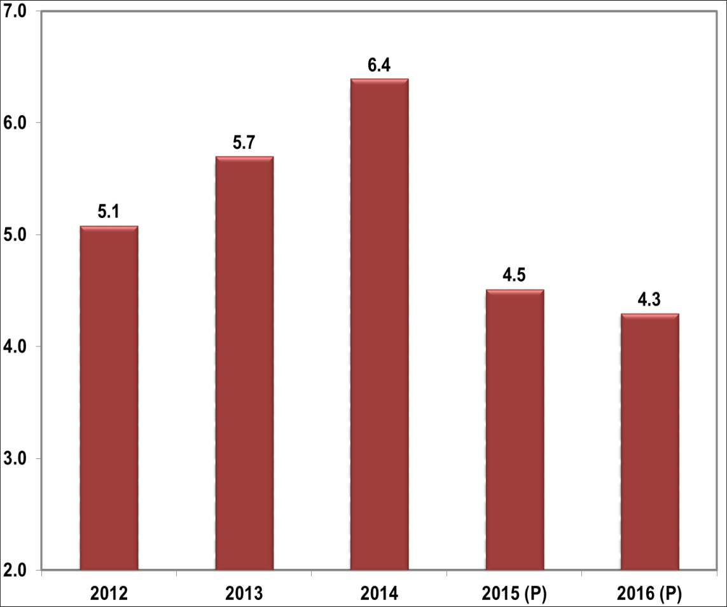
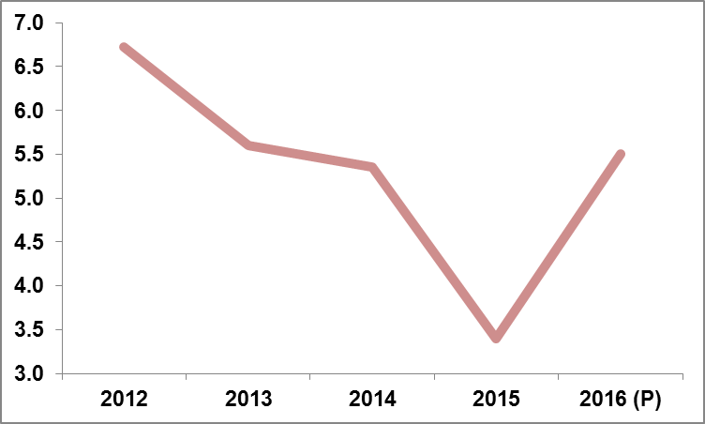
Key Namibian Economic Indicators
Inflation pressures mounting
GDP to slow down

Slide 4
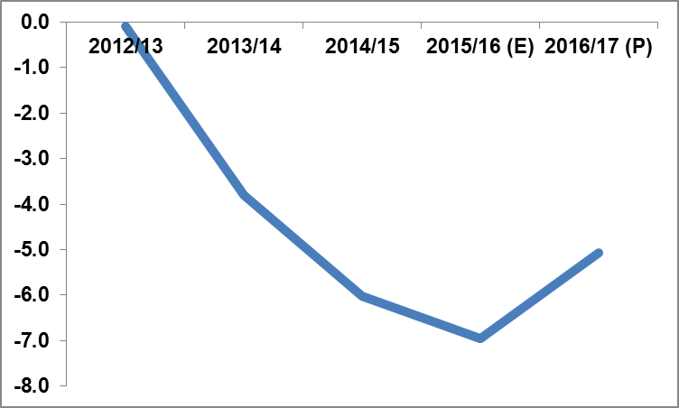
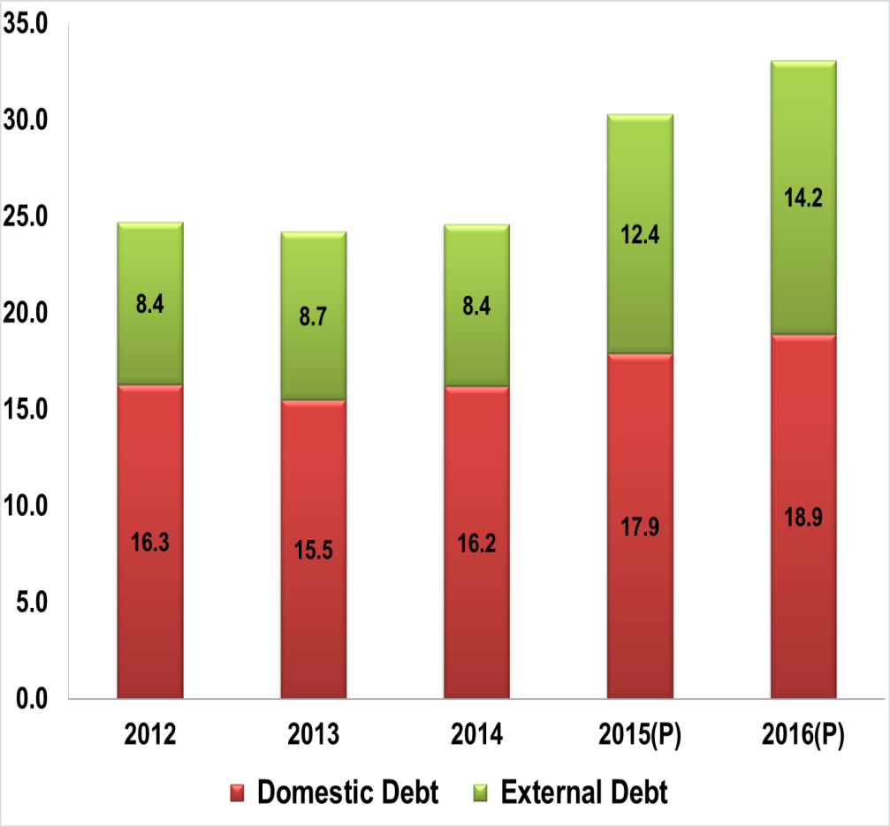
Key Namibian Economic Indicators
Fiscal deficit (as % of GDP)
Debt to GDP ratio to increase

Slide 5
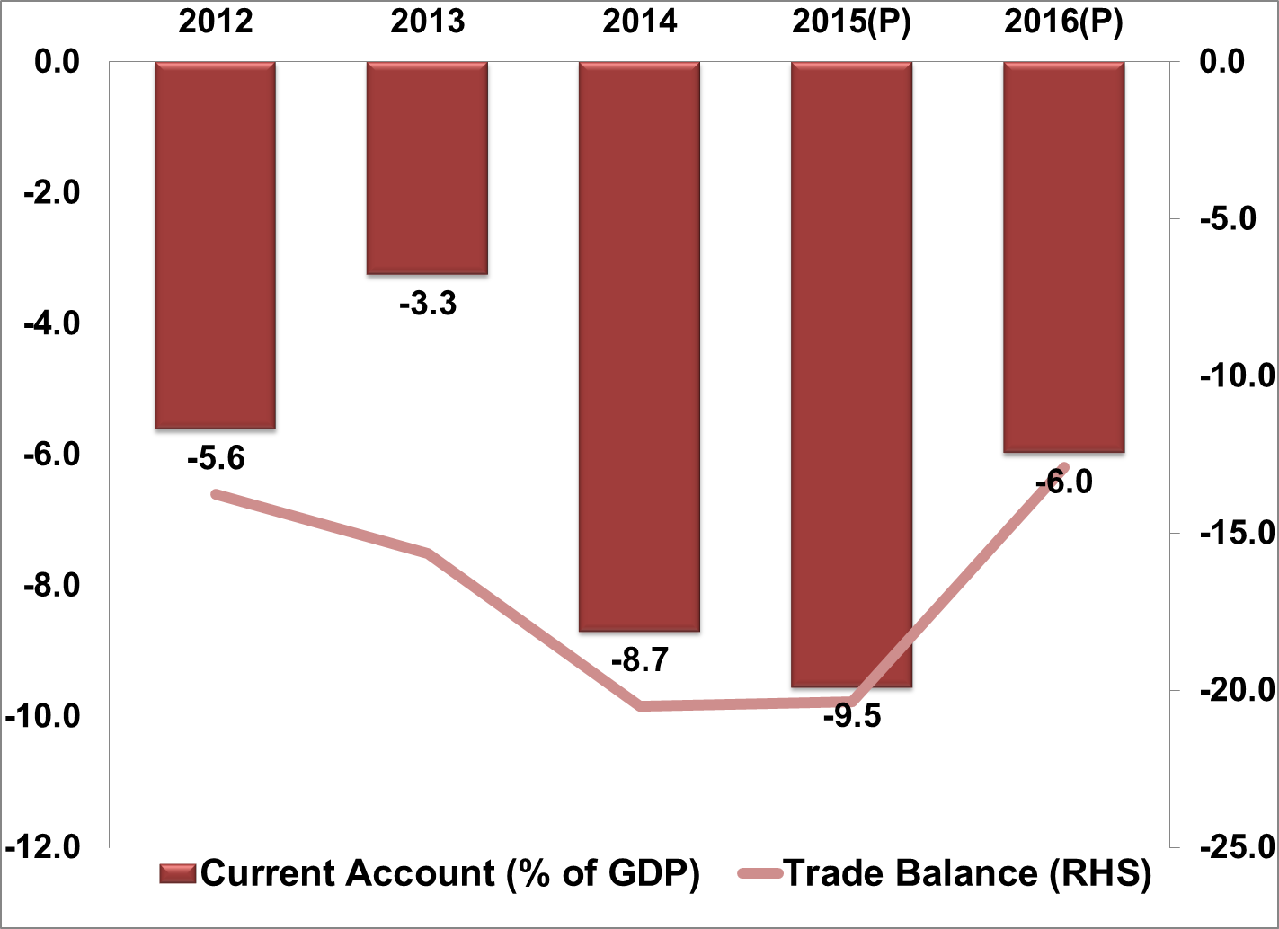
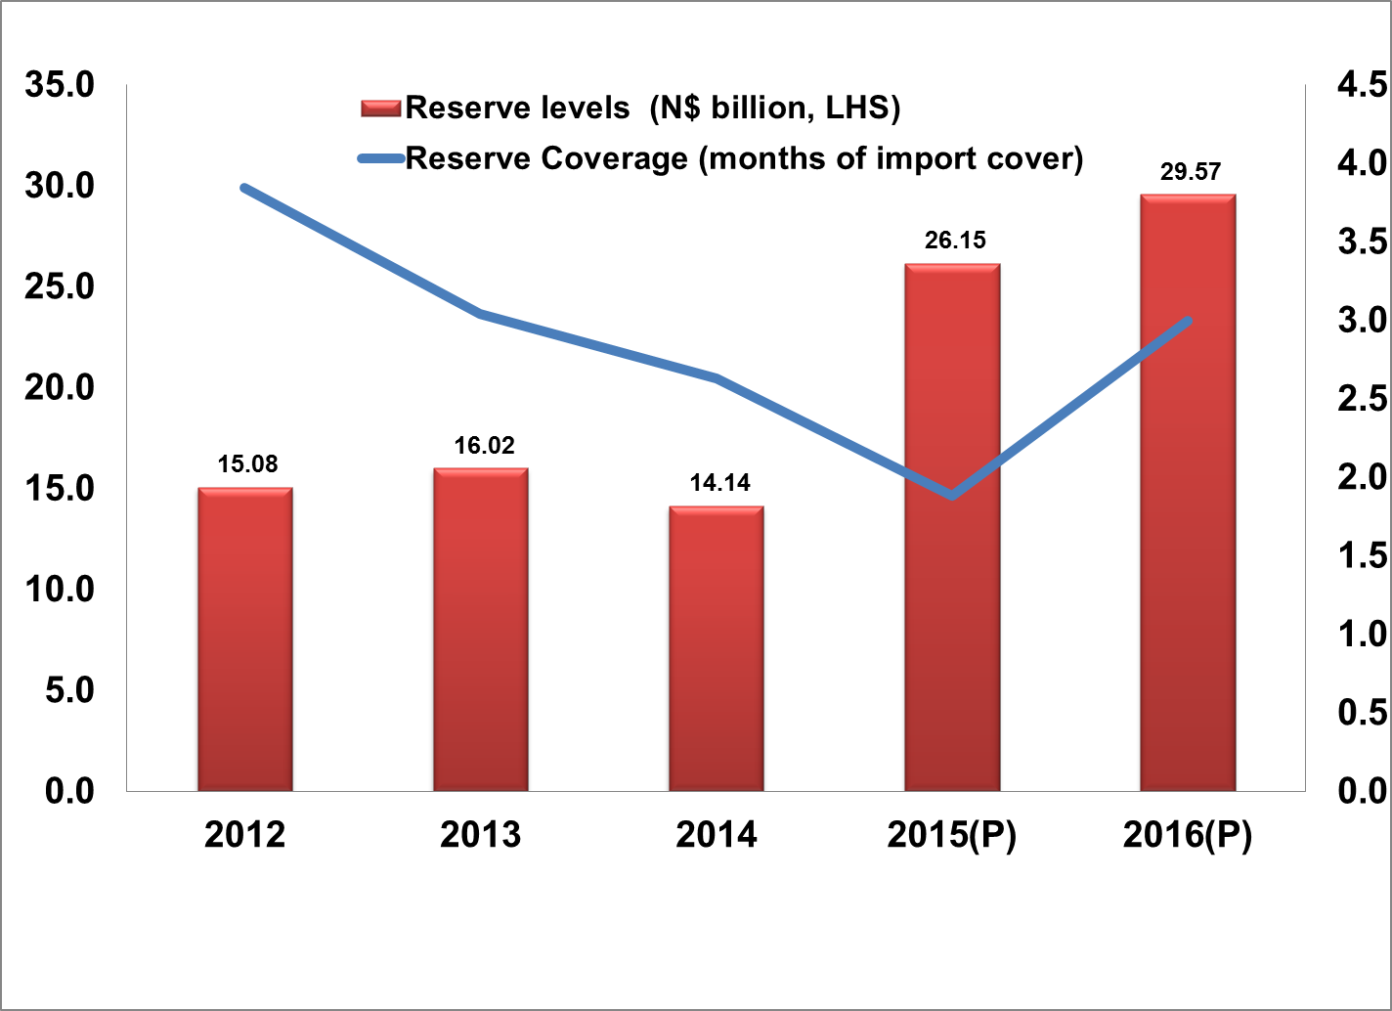
Key Namibian Economic Indicators
External position to improve

Slide 6

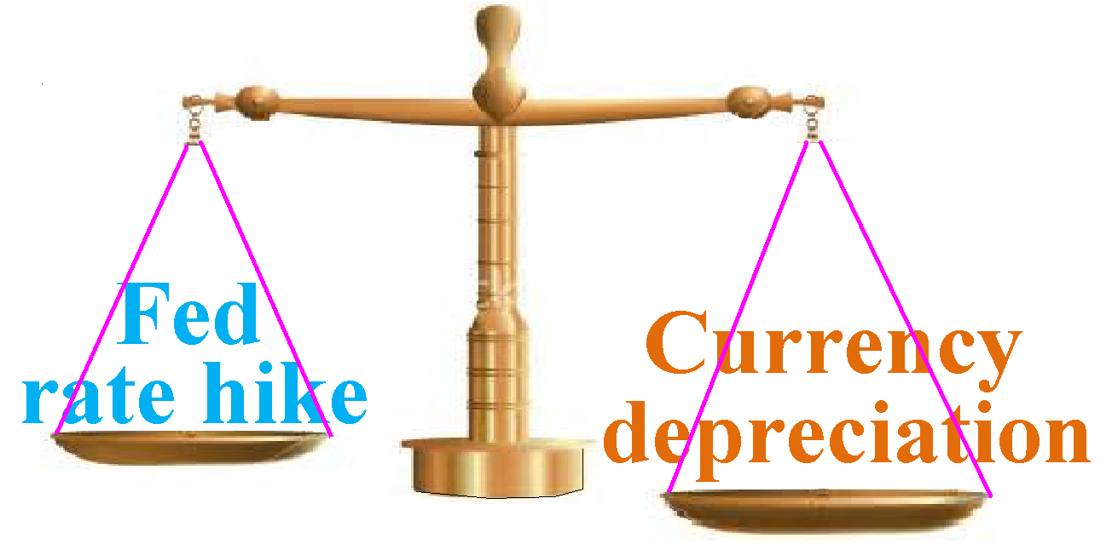
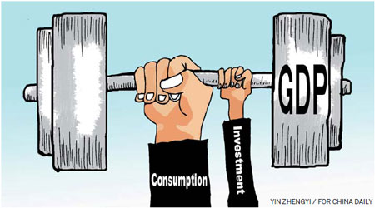
External Developments – Key Transitional Factors
Lower Commodity Prices
Normalisation of the US monetary policy
Global slowdown and China’s economic rebalancing

Slide 7



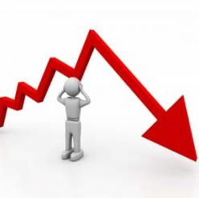
Risks and Impacts to Namibian Economy
Weaker fiscal positions
Increased risks of downgraded by credit rating agencies
Liquidity strain
Reserves under pressure

Slide 8
Policy Actions
Fiscal consolidation
- Minimize non-core expenditure
- Ensure minimal impact on growth and social inclusion
- Build fiscal buffers
Strengthen financial sector system
Build resilience to external shocks
  Diversification of export products away from commodities
  Maintain and build foreign reserves

Slide 9


